Slide 1
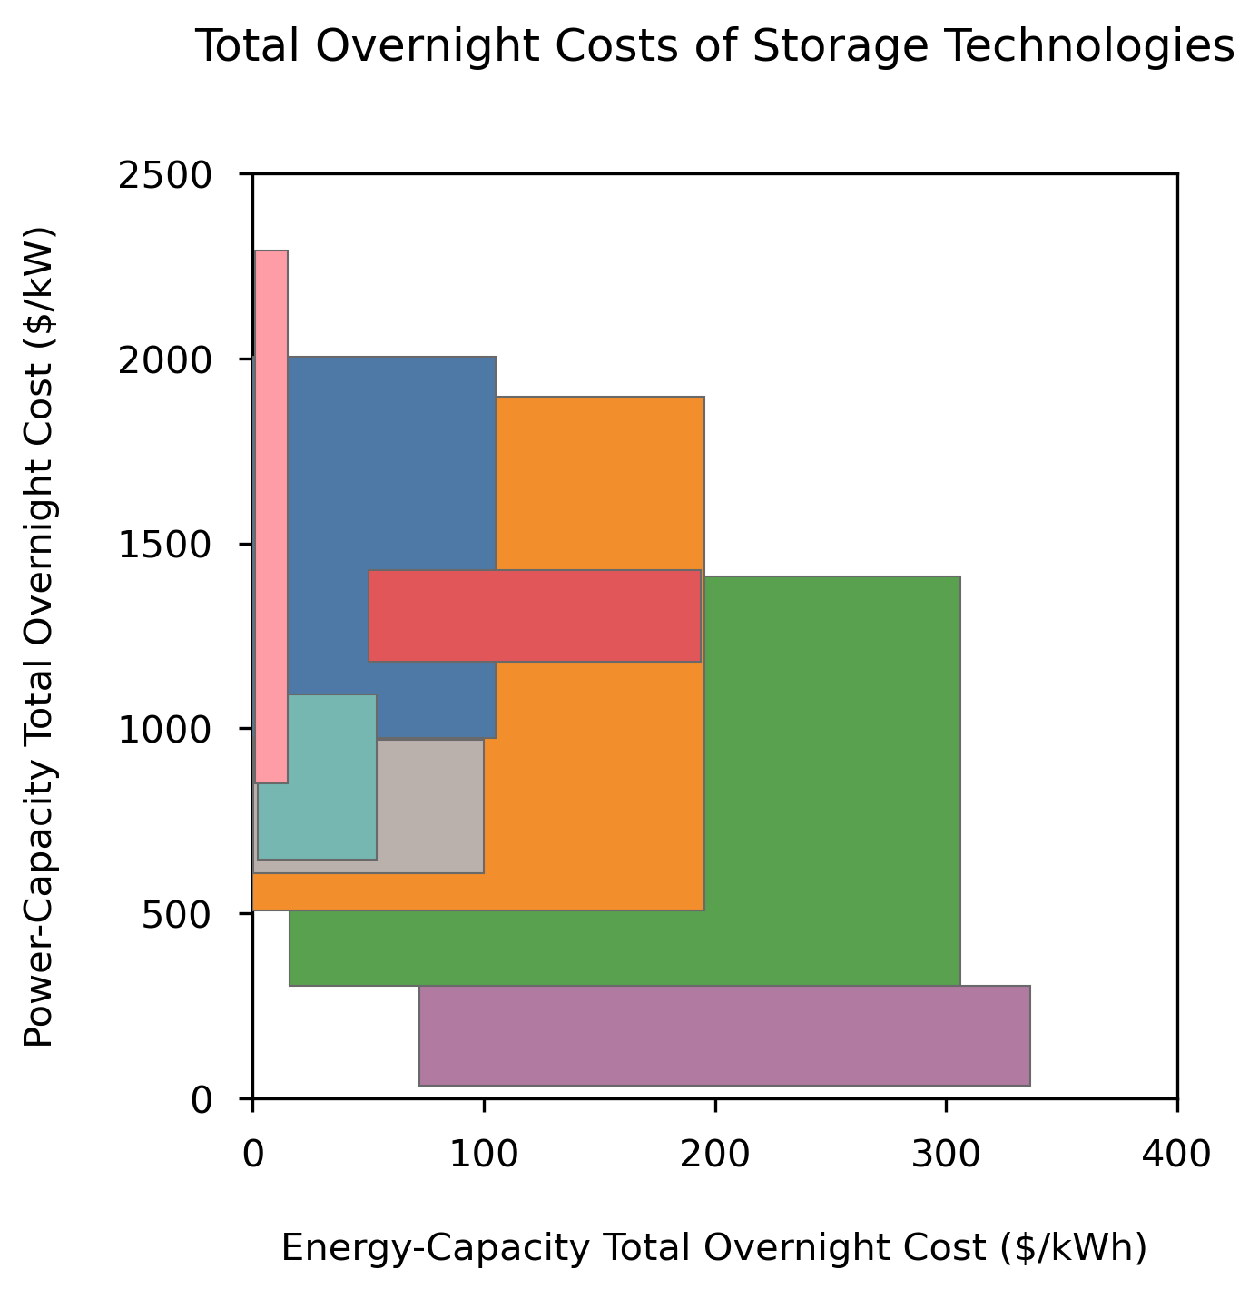
Electrolytic Hydrogen
Pumped Storage Hydro-
power
Thermal
Gravity
Compressed Air Energy Storage
Redox Flow Batteries
Metal-Air Batteries *
Li-ion *

Slide 2
Solar
Wind
Demand
Curtailment
Electricity Load
Electricity Generation
Electric Power
Key
Energy Storage
Power Conversion
Electrolyzers
Fuel Cells
Time Series Data
Combined Energy/Power
Energy Storage
Cavern Storage
Technology Power Component
Technology Energy Component
Representative Short-Duration Technology:
Li-ion battery storage
Example Mid-Duration Technology
or
Storage X
Representative Long-Duration Technology:
Electrolytic Hydrogen Storage

Slide 3
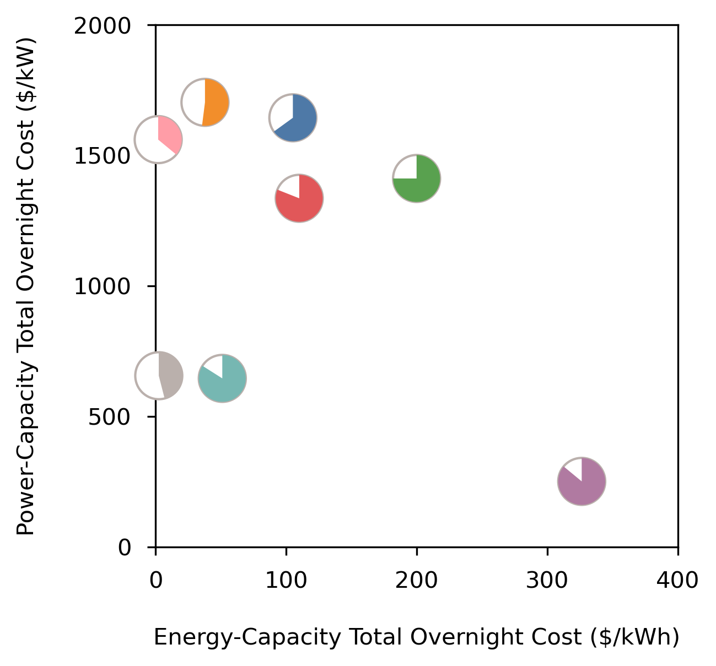
Thermal
PHS
RFB
Hydrogen
Gravity
Metal-Air *
Li-ion *
CAES

Slide 4
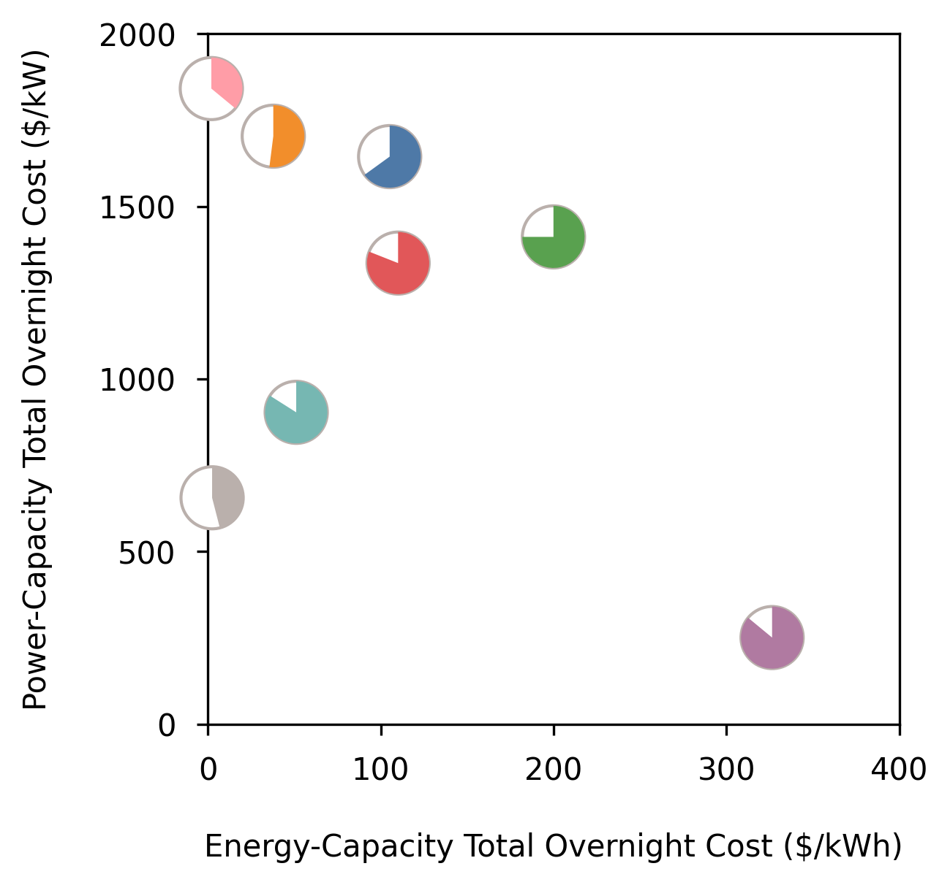
Hydrogen †
PSH
RFB
Thermal
CAES †
Gravity
Metal-Air *
Li-ion *

Slide 5
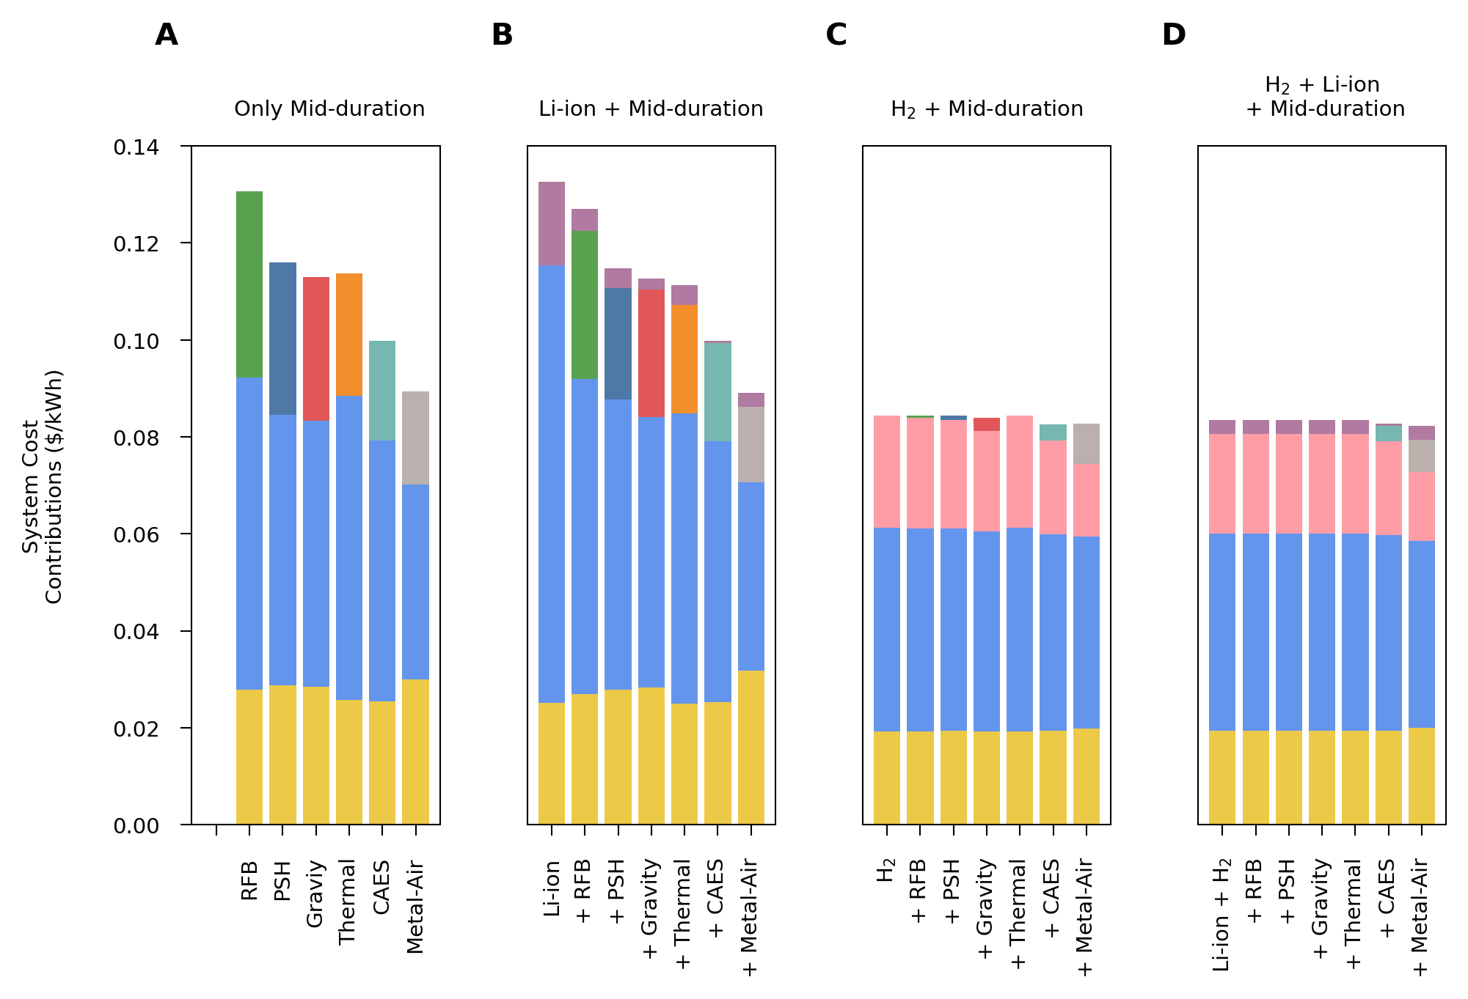
Li-ion
* Mid-duration storage is not cost competitive
* Mid-duration storage is not cost competitive
System Cost Reduction
RFB
RFB
PSH
Thermal
PSH
Gravity
Gravity
Li-ion
Thermal
CAES
CAES
*
*
*
*
*
M-Air
M-Air
Hydrogen
Hydrogen
Wind
Wind
Wind
Wind
Solar
Solar
Solar
Solar

Slide 6
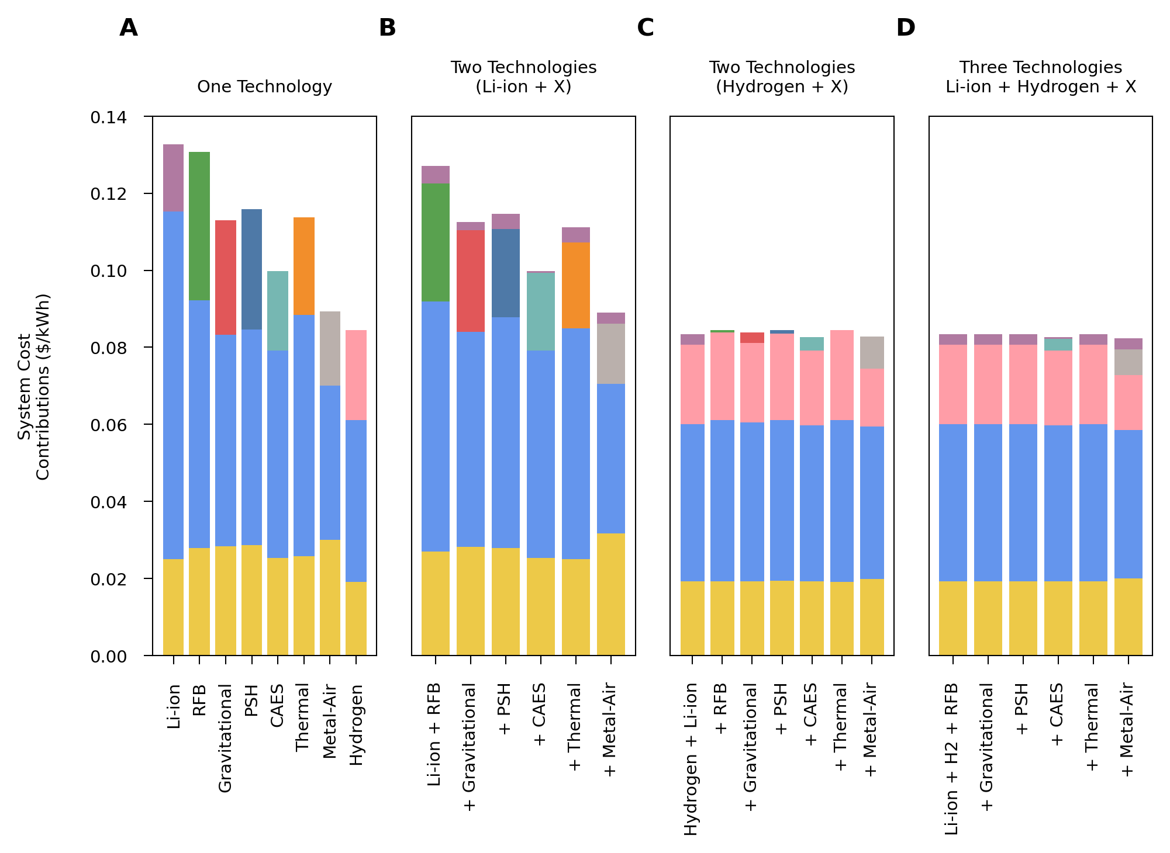
Li-ion
Energy Cost Reduction
Li-ion
RFB
RFB
Gravity
PSH
Thermal
PSH
Li-ion
Gravity
Thermal
CAES
CAES
M-Air
M-Air
Hydrogen
Hydrogen
Hydrogen
Wind
Wind
Wind
Wind
Solar
Solar
Solar
Solar

Slide 7
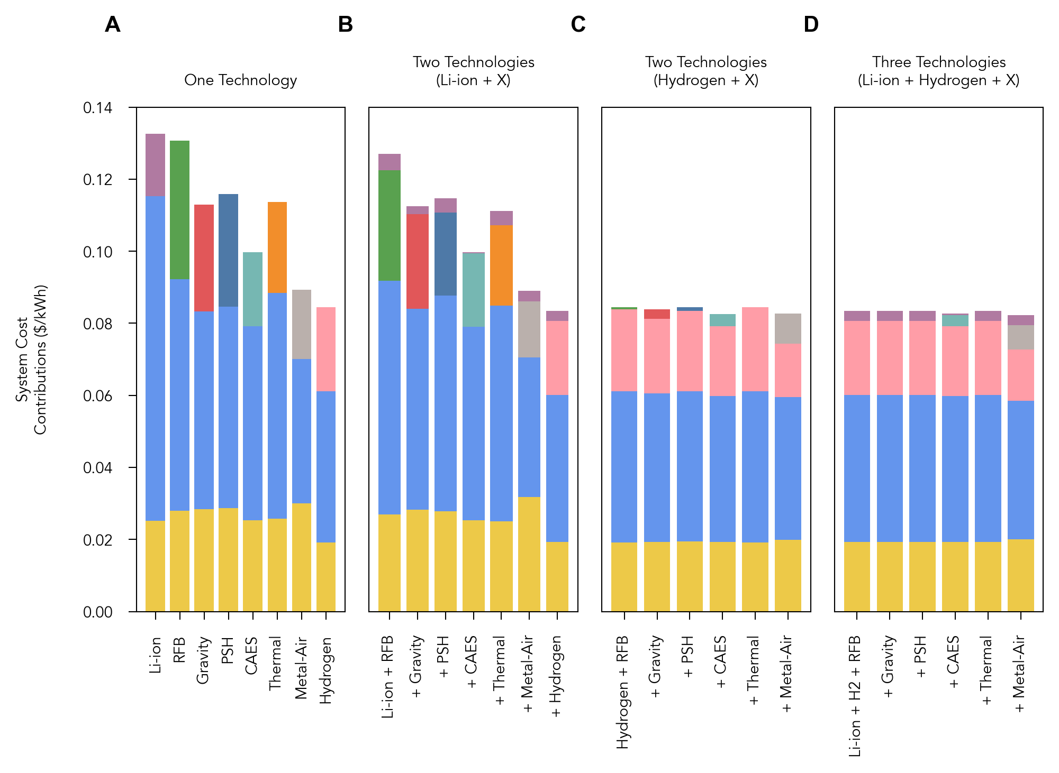
Li-ion
Li-ion
RFB
Gravity
PSH
Thermal
Li-ion
CAES
Metal-Air
Hydrogen
Hydrogen
Hydrogen
Wind
Wind
Wind
Wind
Solar
Solar
Solar
Solar

Slide 8
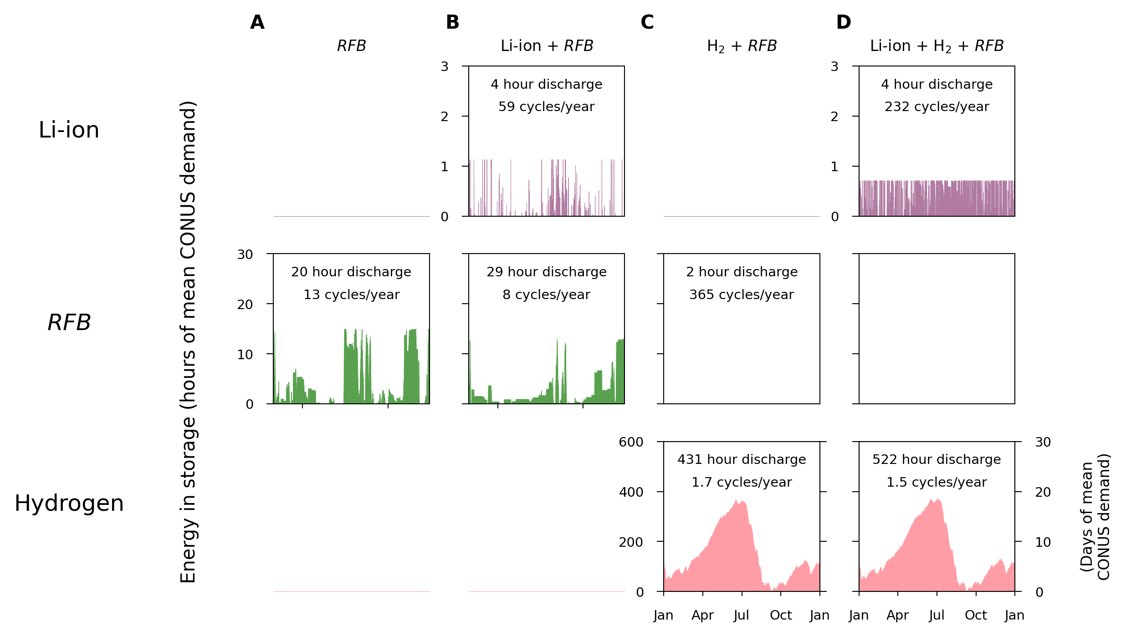
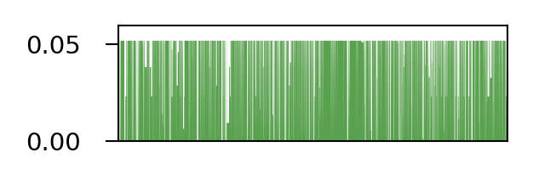
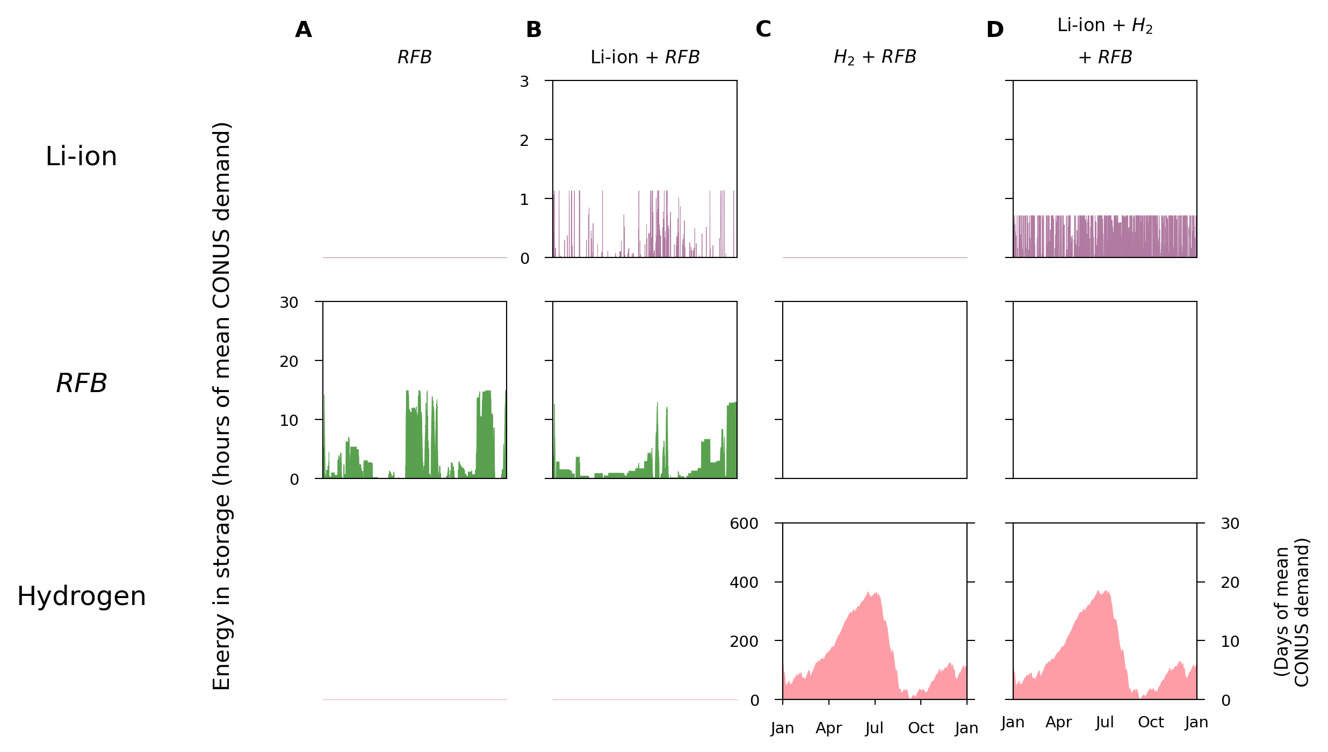
Not present in least-cost system

Slide 9
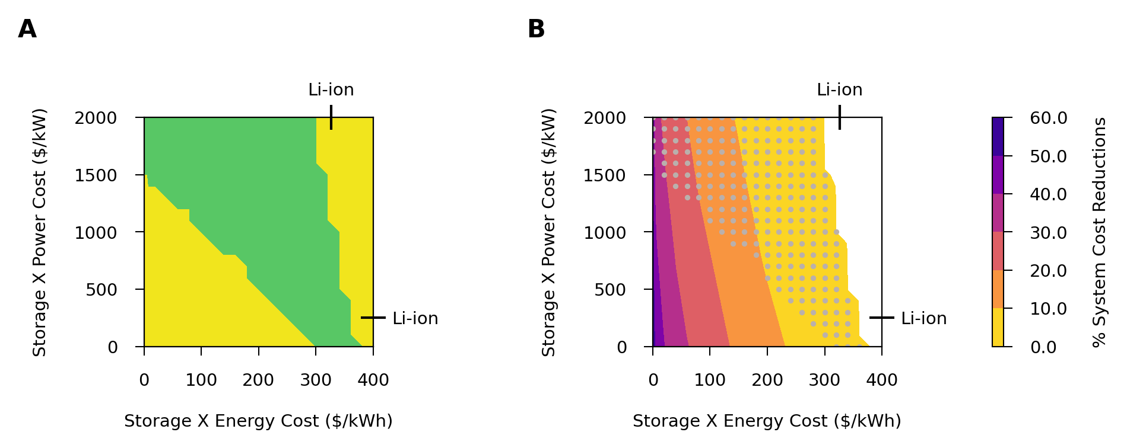
Li-ion and Storage X compete
only Li-ion
Li-ion + Storage X
only Storage X

Slide 10

only Li-ion
Li-ion + Storage X
only Storage X

Slide 11
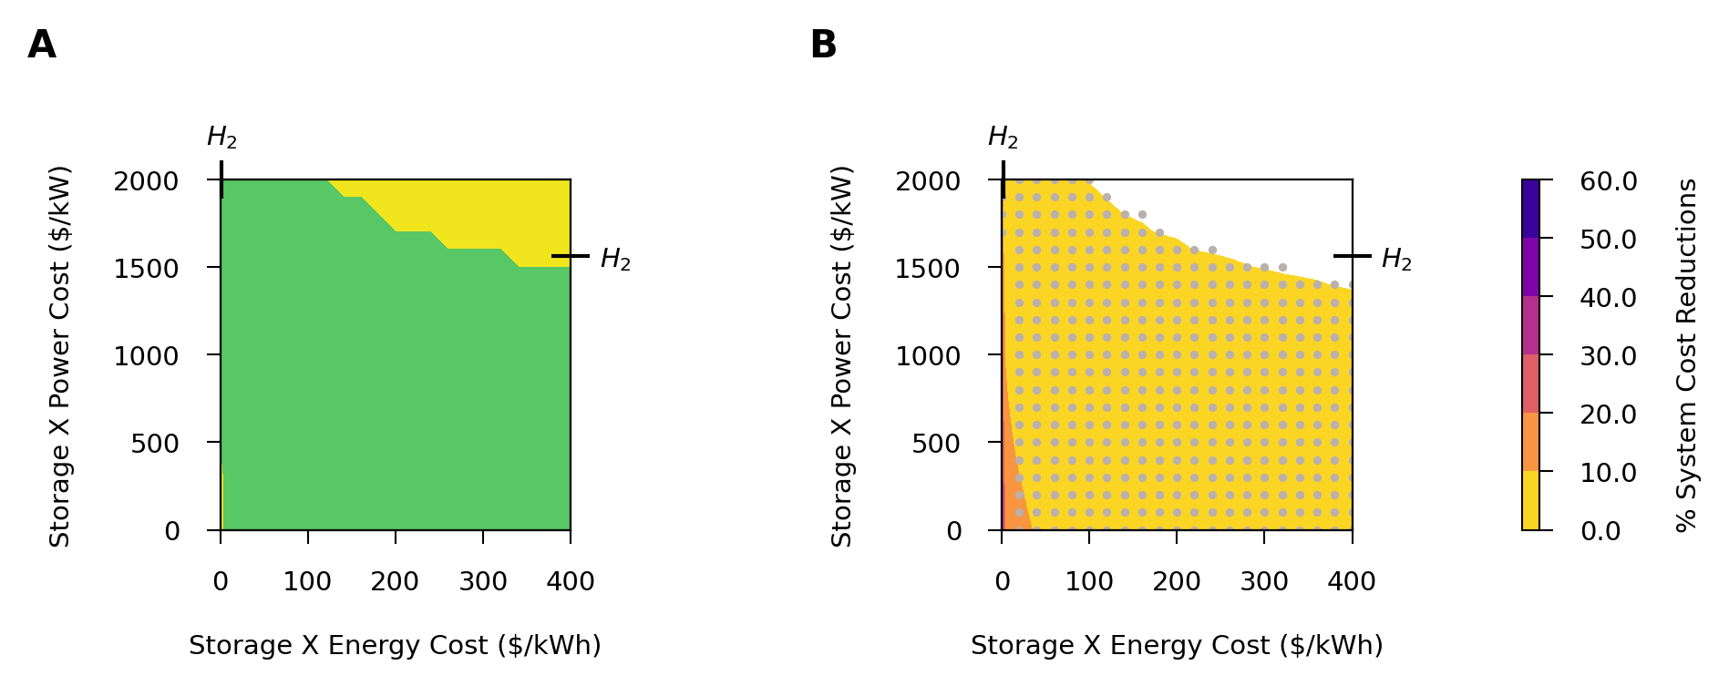
Hydrogen and Storage X compete
only Hydrogen
Hydrogen + Storage X
only Storage X

Slide 12

only Hydrogen
Hydrogen + Storage X
only Storage X

Slide 13
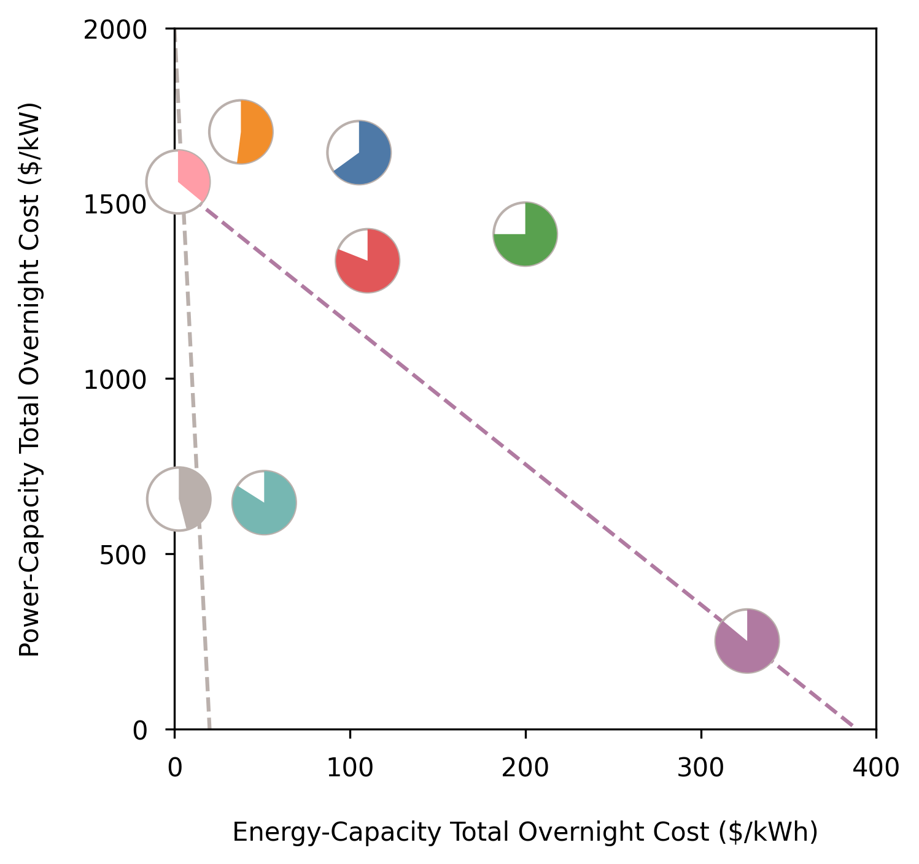
Thermal
PHS
RFB
Hydrogen
Gravity
Metal-Air *
CAES
Li-ion *

Slide 14
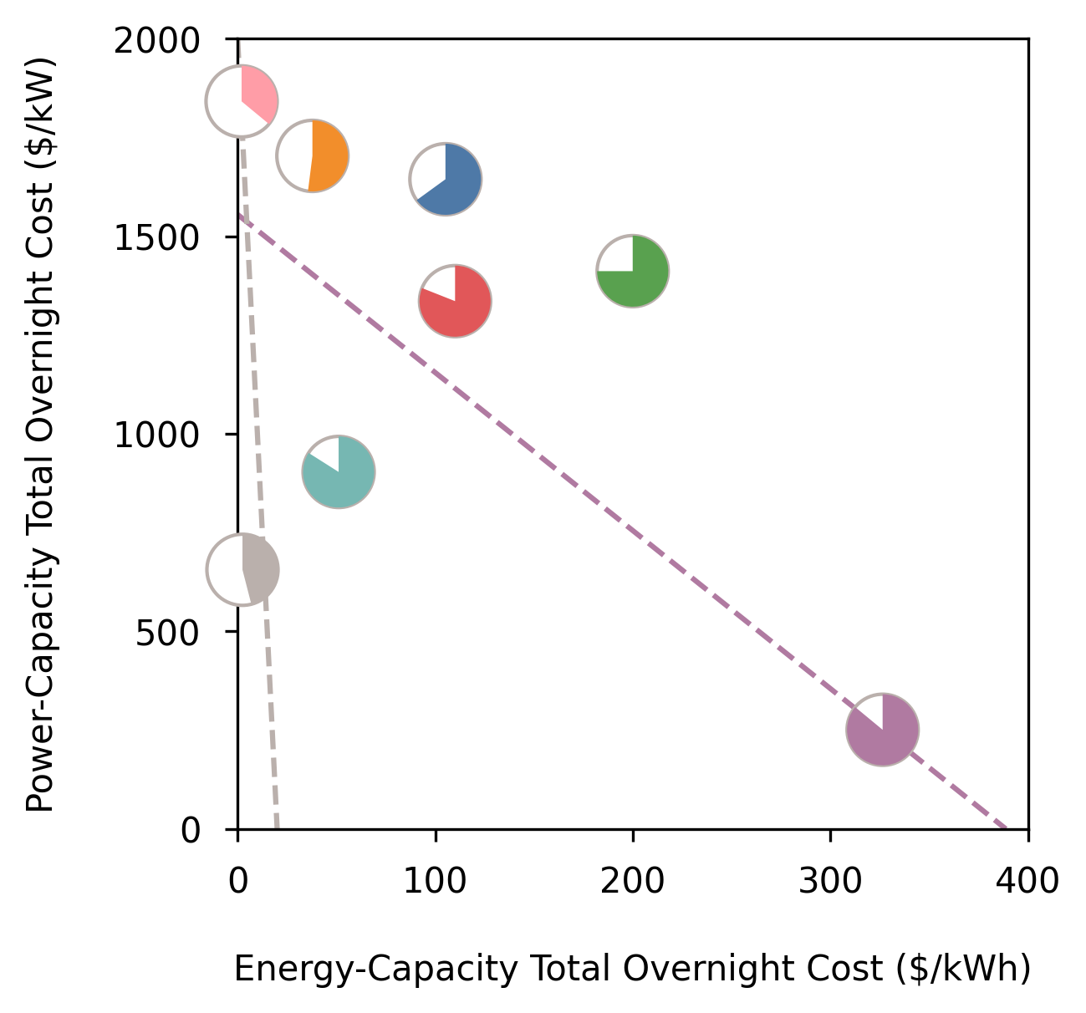
Hydrogen †
PSH
RFB
Thermal
CAES †
Gravity
Metal-Air *
Li-ion *

Slide 15
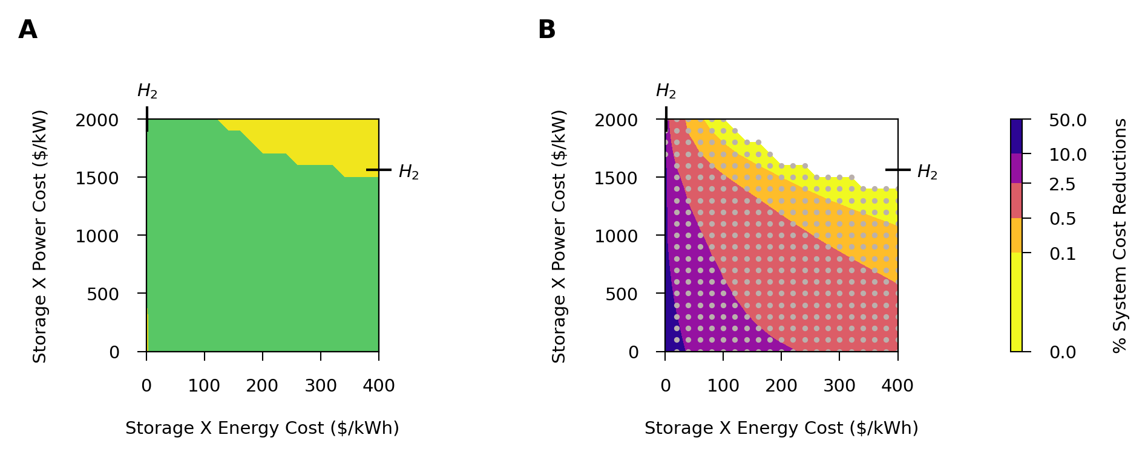
Hydrogen and Storage X compete
only Hydrogen
Hydrogen + Storage X
only Storage X

Slide 16
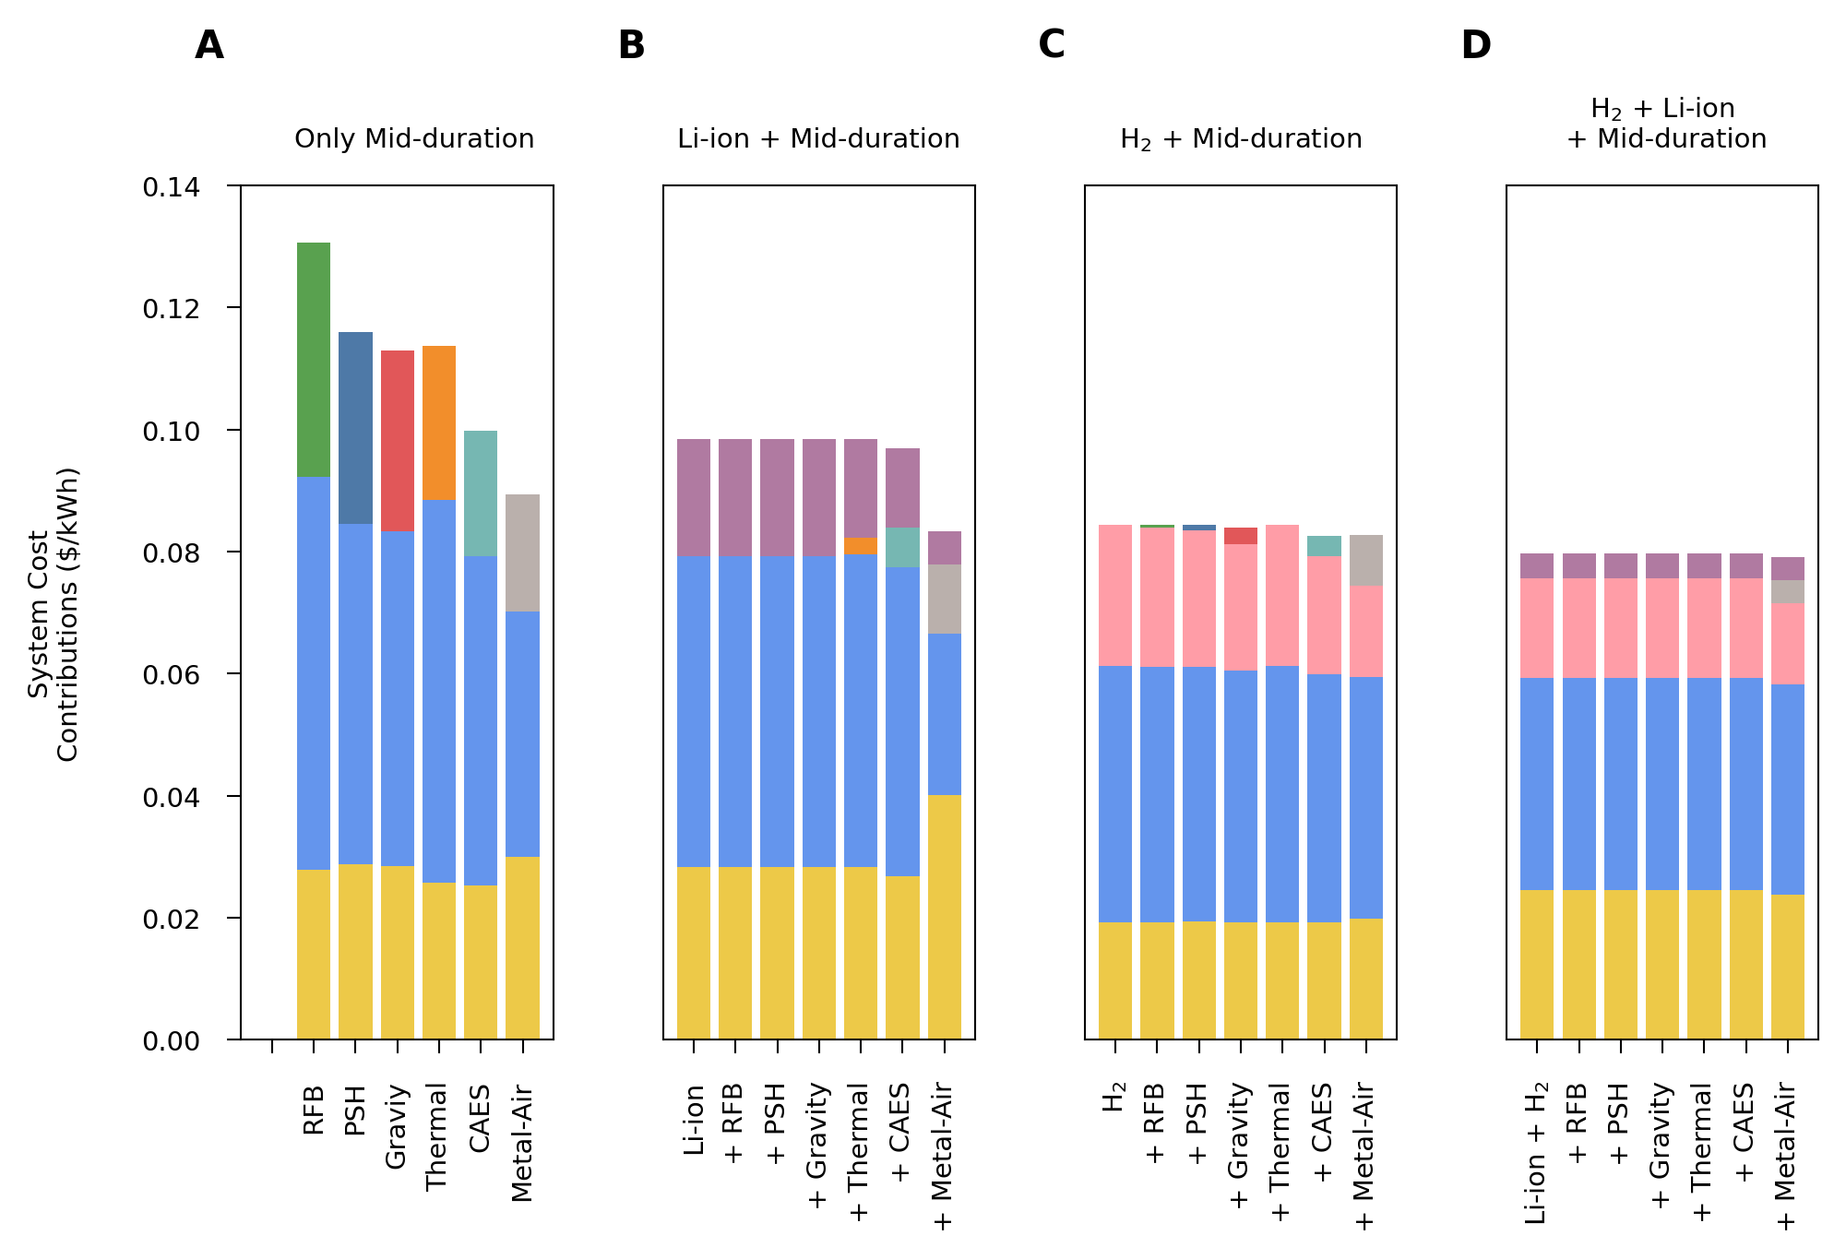
* Mid-duration storage is not cost competitive
* Mid-duration storage is not cost competitive
* Mid-duration storage is not cost competitive
RFB
Li-ion
PSH
Thermal
*
*
*
Gravity
Li-ion
CAES
*
M-Air
*
*
*
*
*
Hydrogen
Hydrogen
Wind
Wind
Wind
Wind
Solar
Solar
Solar
Solar

Slide 17
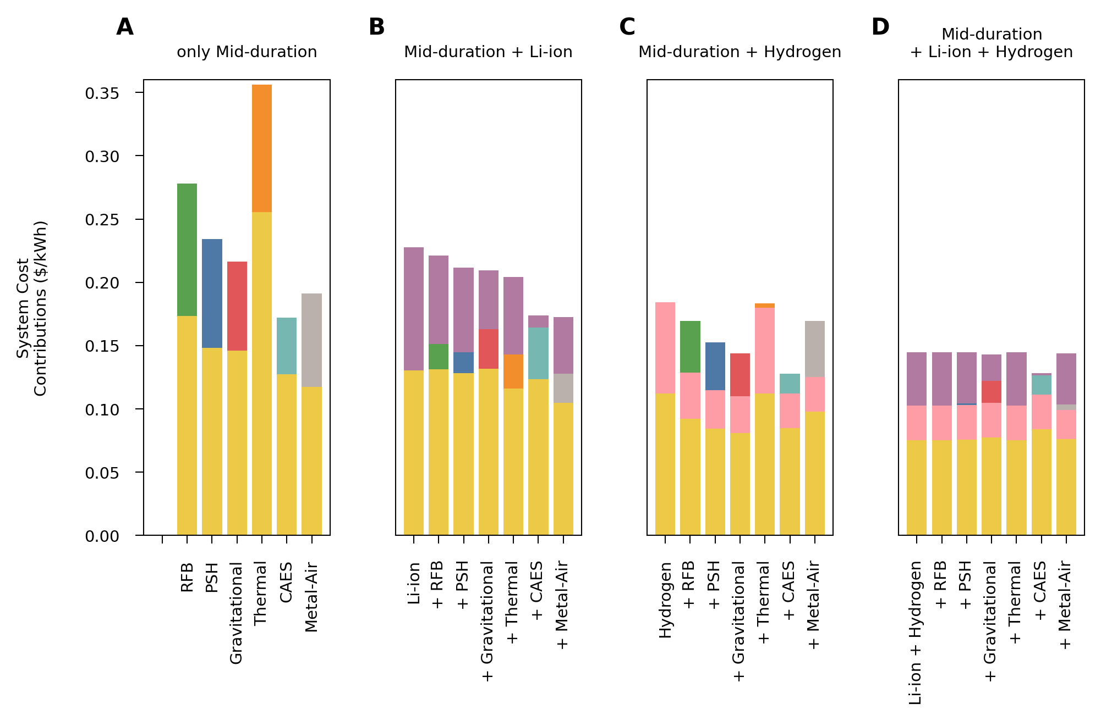
* Mid-duration storage is not cost competitive
Thermal
Li-ion
RFB
PSH
Gravity
Li-ion
CAES
M-Air
*
*
Hydrogen
Hydrogen
Solar
Solar
Solar
Solar

Slide 18
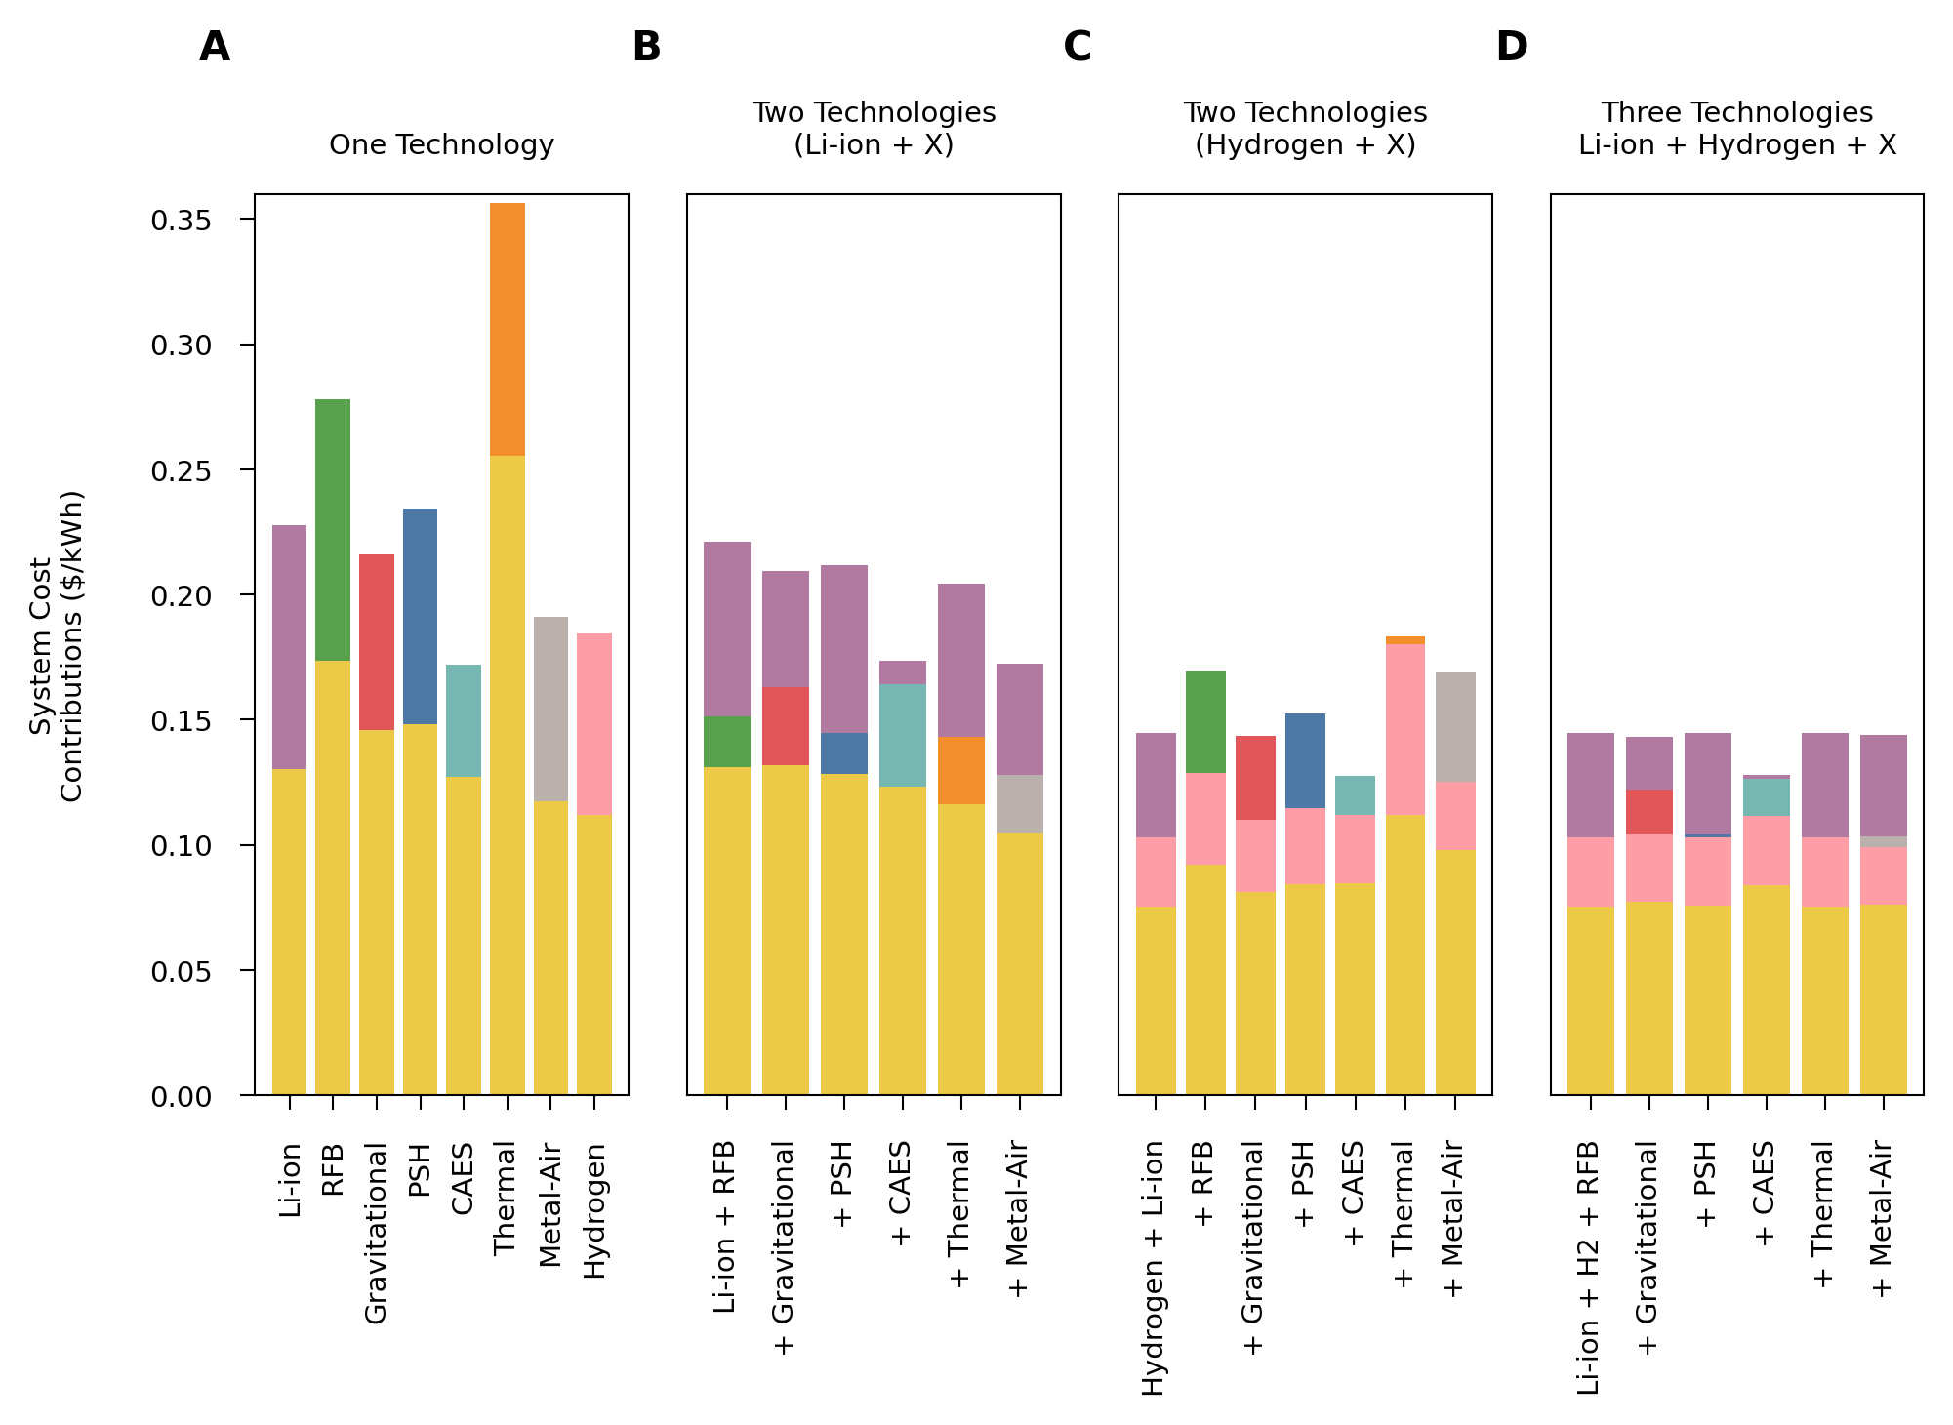
Thermal
RFB
Li-ion
PSH
Gravity
Li-ion
M-Air
CAES
Hydrogen
Hydrogen
Hydrogen
Solar
Solar
Solar
Solar

Slide 19
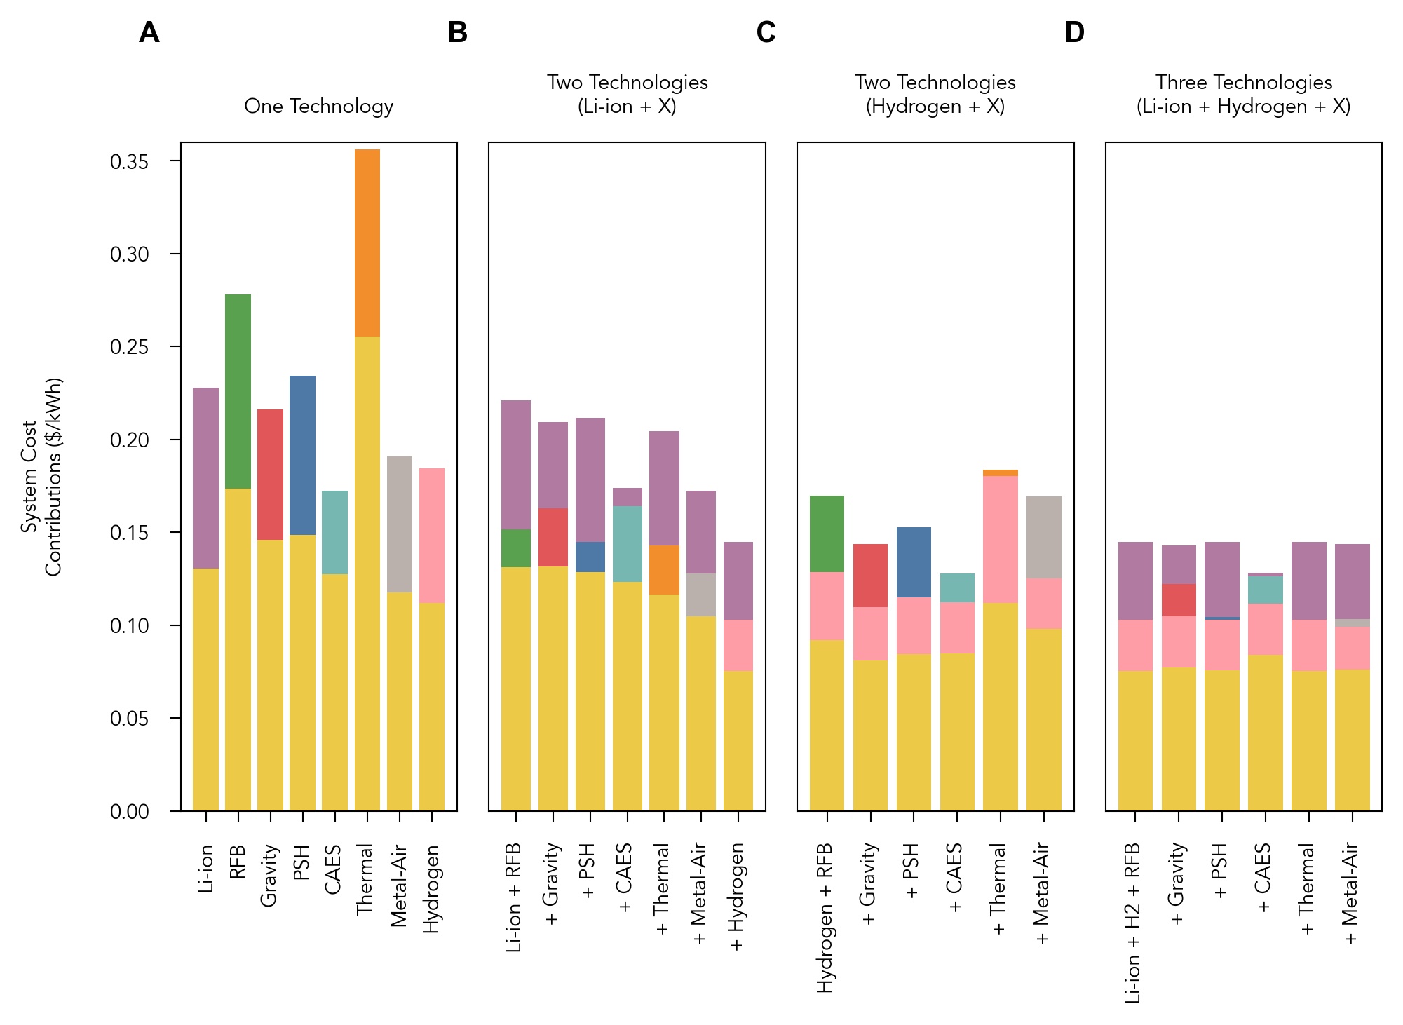
Thermal
RFB
Li-ion
Gravity
PSH
Li-ion
CAES
Metal-Air
Hydrogen
Hydrogen
Hydrogen
Solar
Solar
Solar
Solar

Slide 20
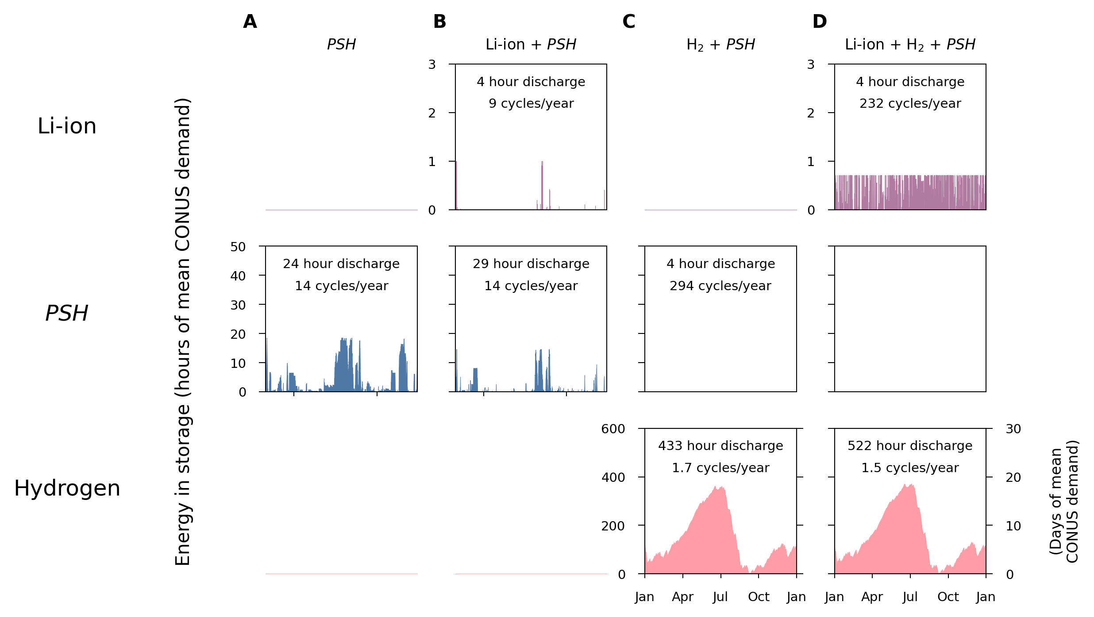
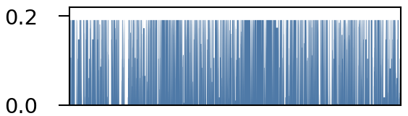
Not present in least-cost system

Slide 21
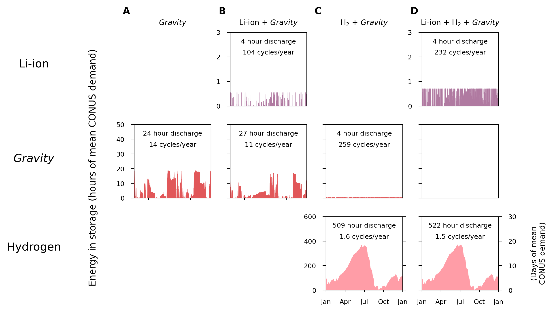
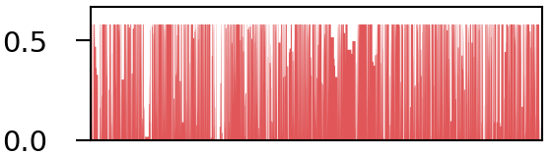
Not present in least-cost system

Slide 22
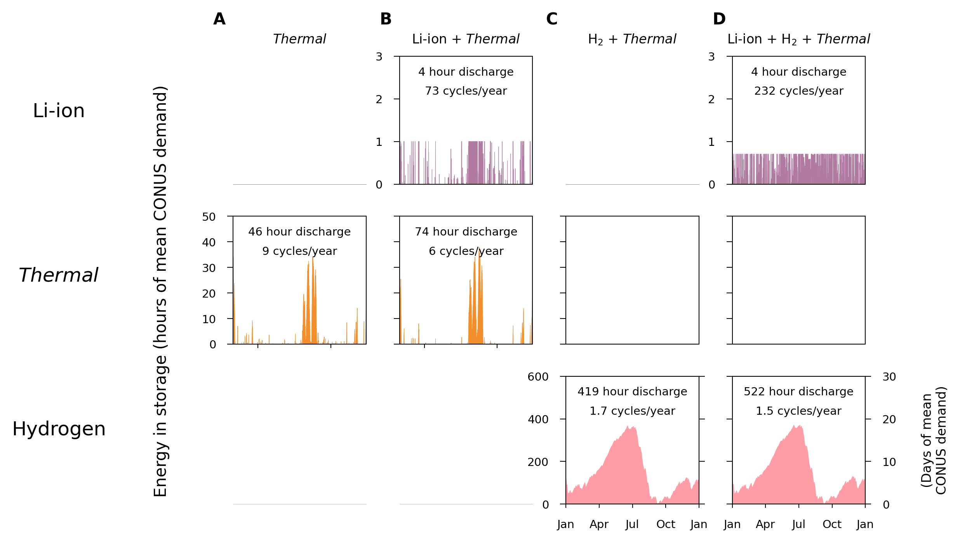
Not present in least-cost system
Not present in least-cost system

Slide 23
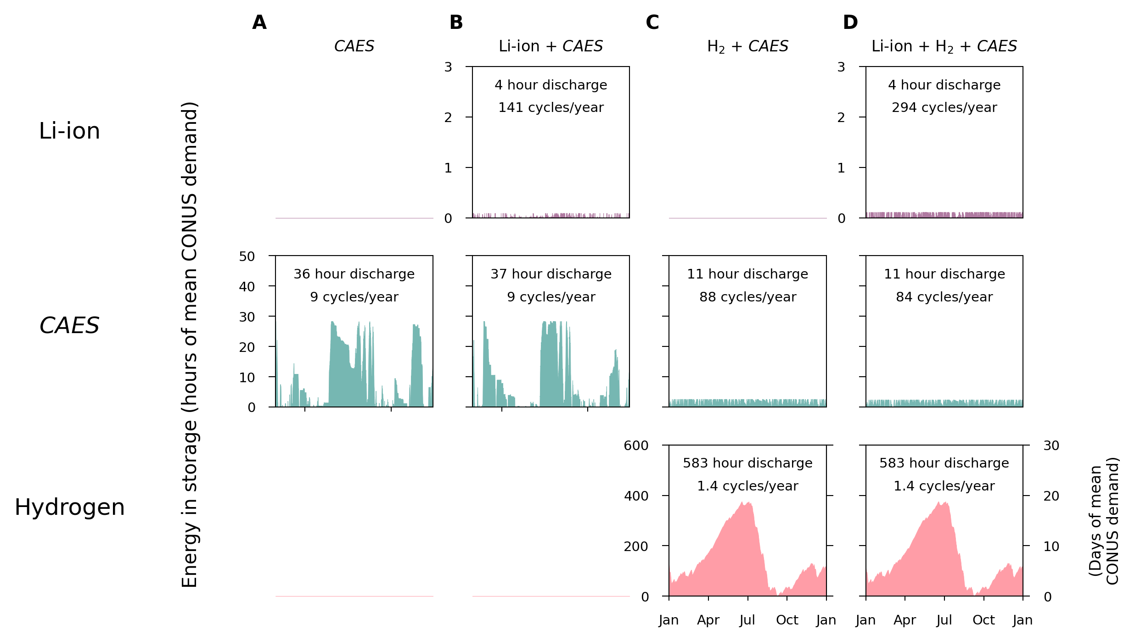
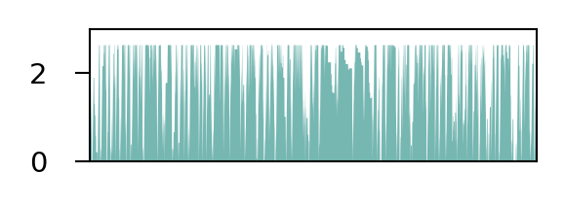
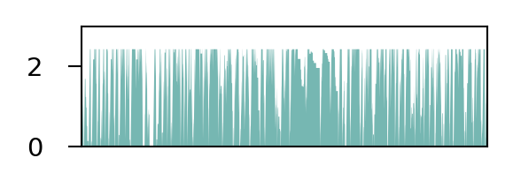

Slide 24
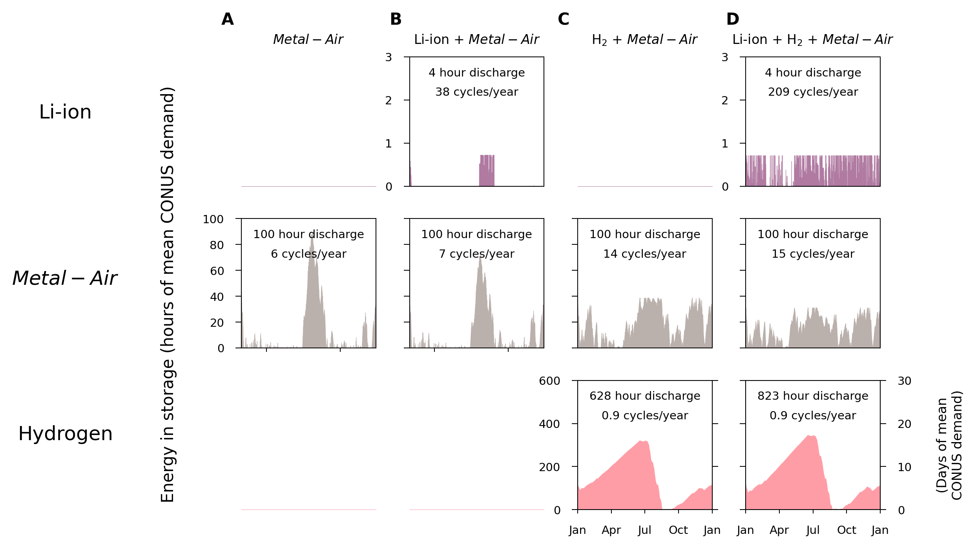

Slide 25
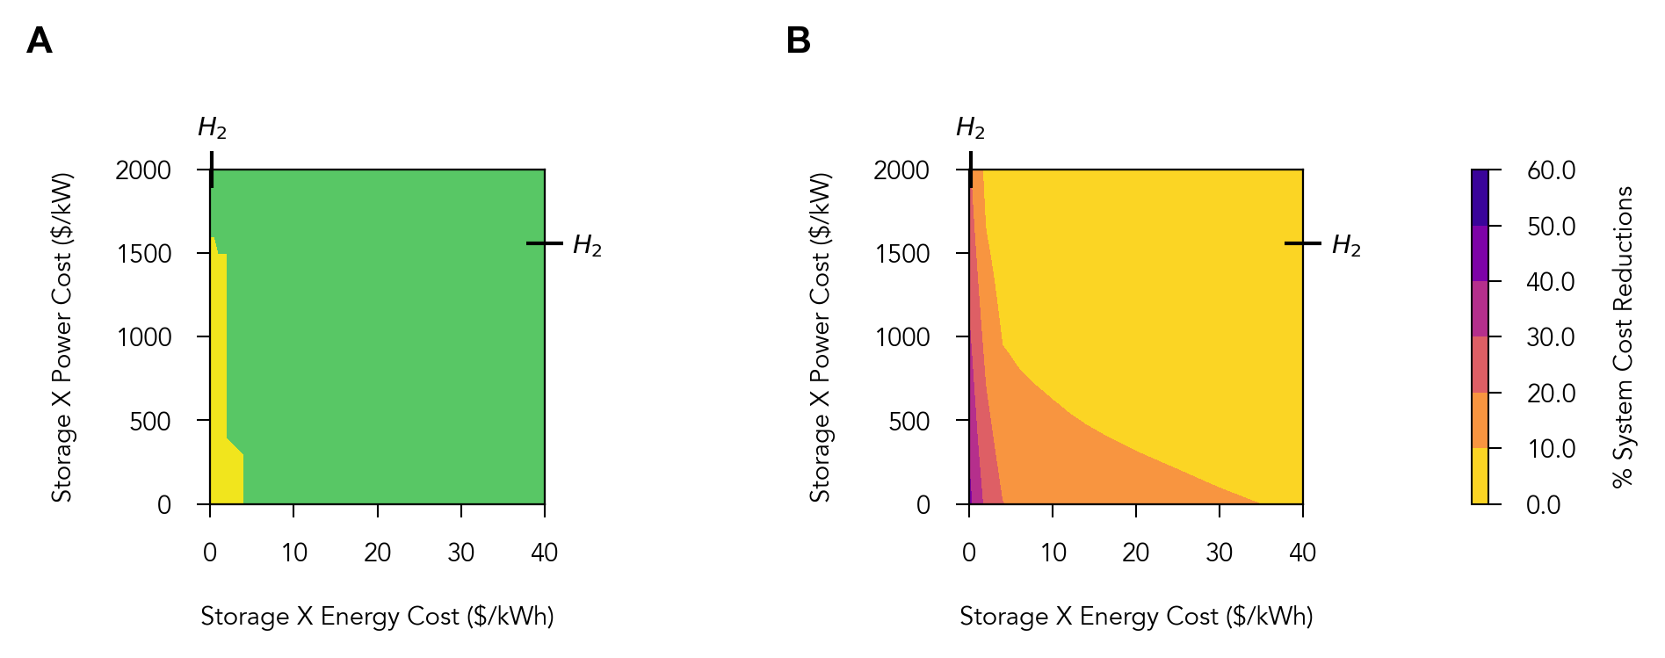
Hydrogen + Storage X
only Storage X

Slide 26
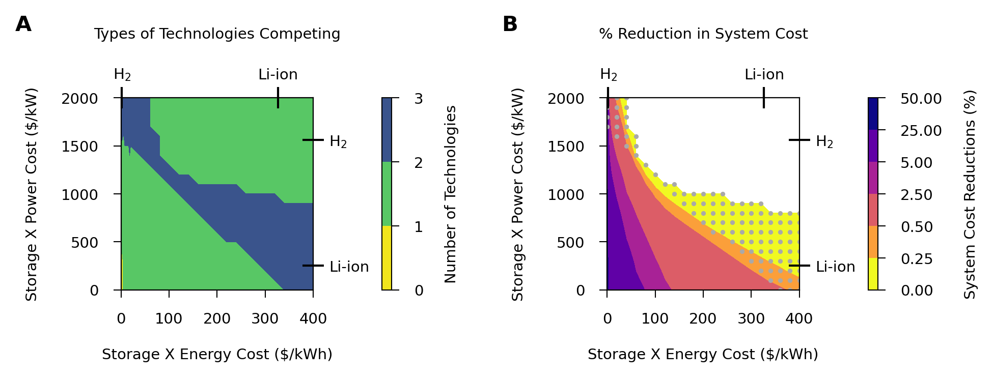
Li-ion + Hydrogen + Storage X
Li-ion, Hydrogen, and Storage X compete
Li-ion + Hydrogen
Li-ion + Hydrogen + Storage X
Hydrogen + Storage X
Only Storage X

Slide 27
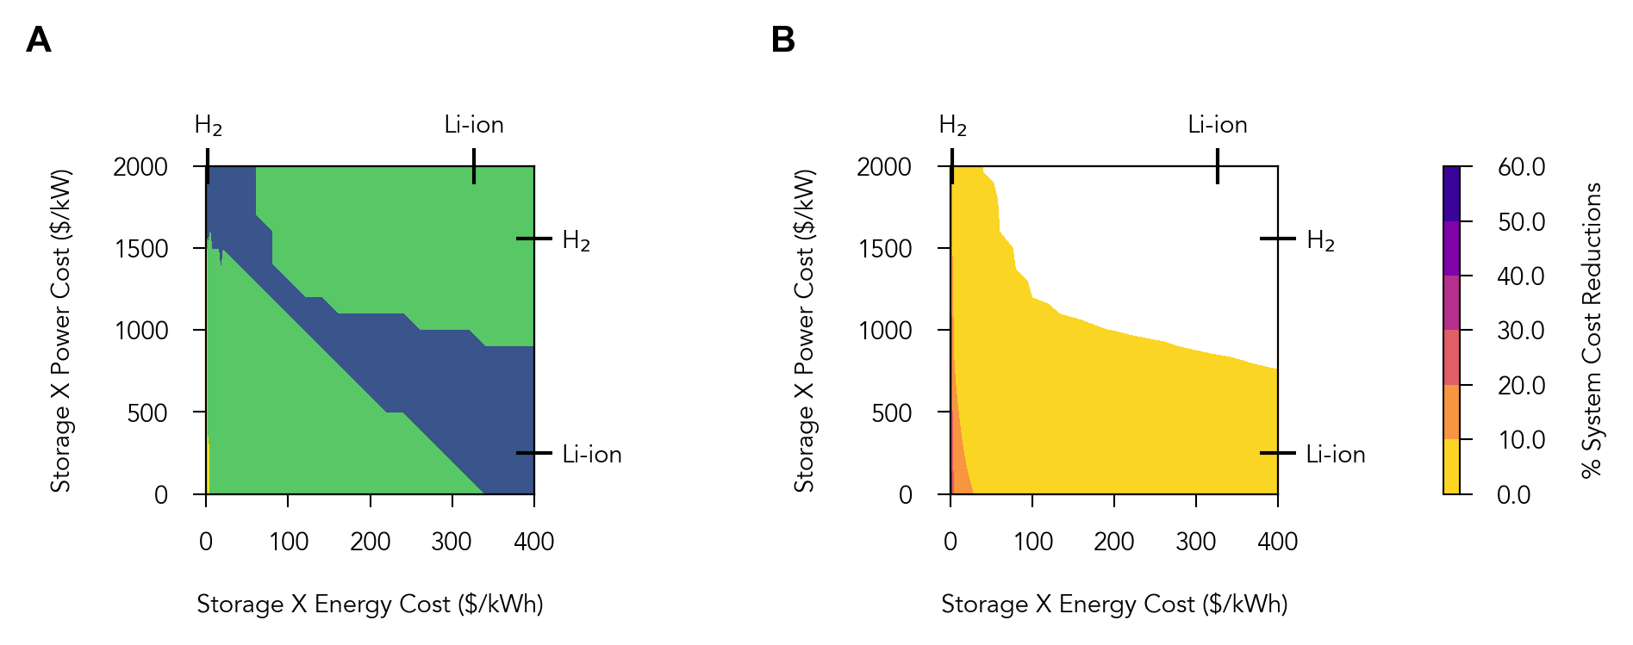
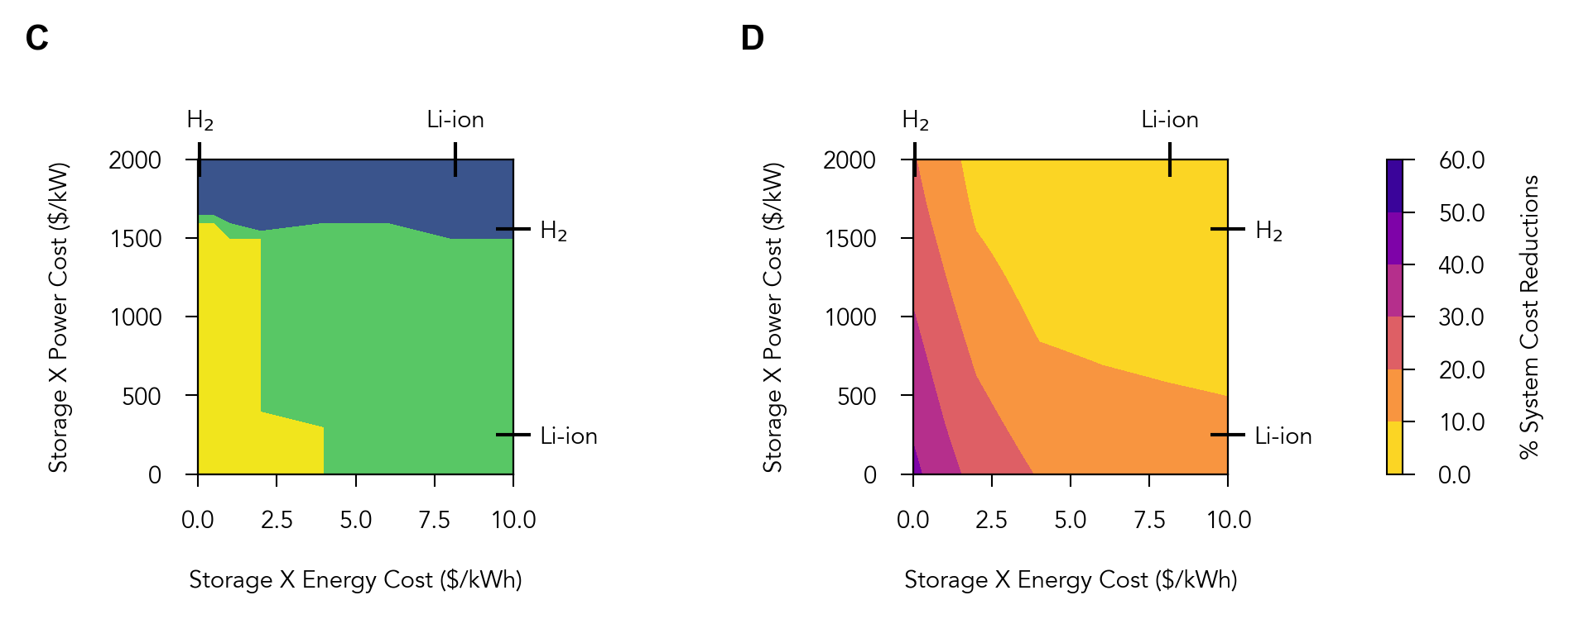
Li-ion + Hydrogen
Li-ion + Hydrogen + Storage X
Hydrogen + Storage X
Only Storage X
Li-ion + Hydrogen + Storage X
Hydrogen + Storage X
Only Storage X

Slide 28
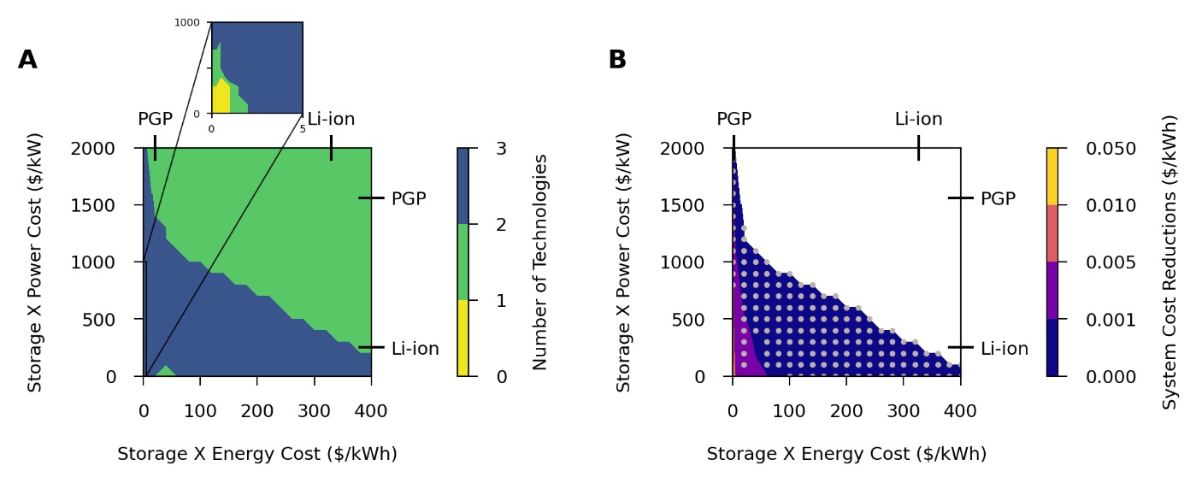
PGP + Storage X
only Storage X
When all three technologies compete
Li-ion + PGP
Li-ion + PGP
+ Storage X

Slide 29
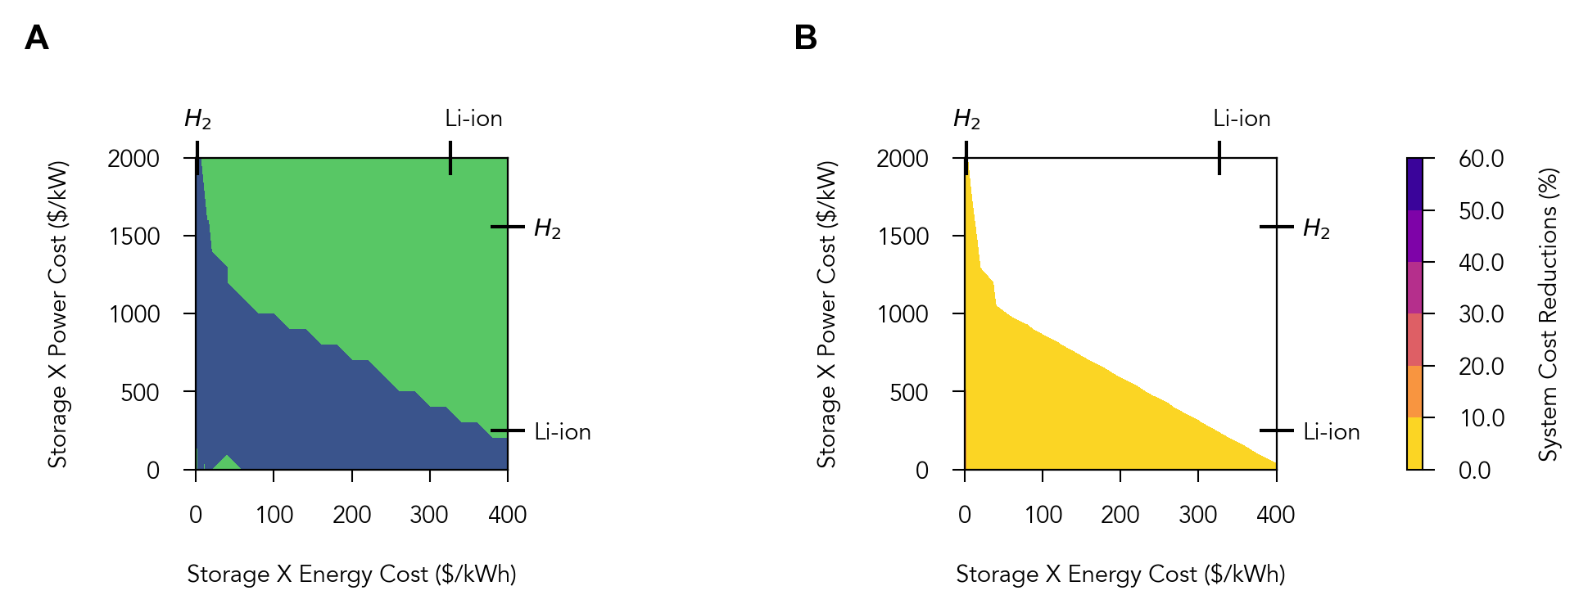
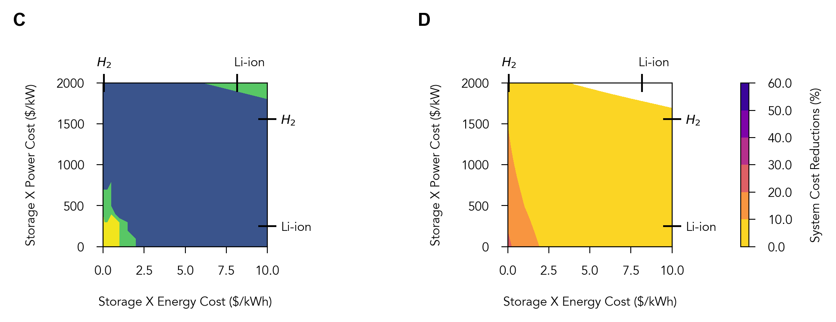
Li-ion + Hydrogen
Li-ion + Hydrogen + Storage X
Li-ion + Hydrogen + Storage X
Hydrogen + Storage X
Only Storage X

Slide 30
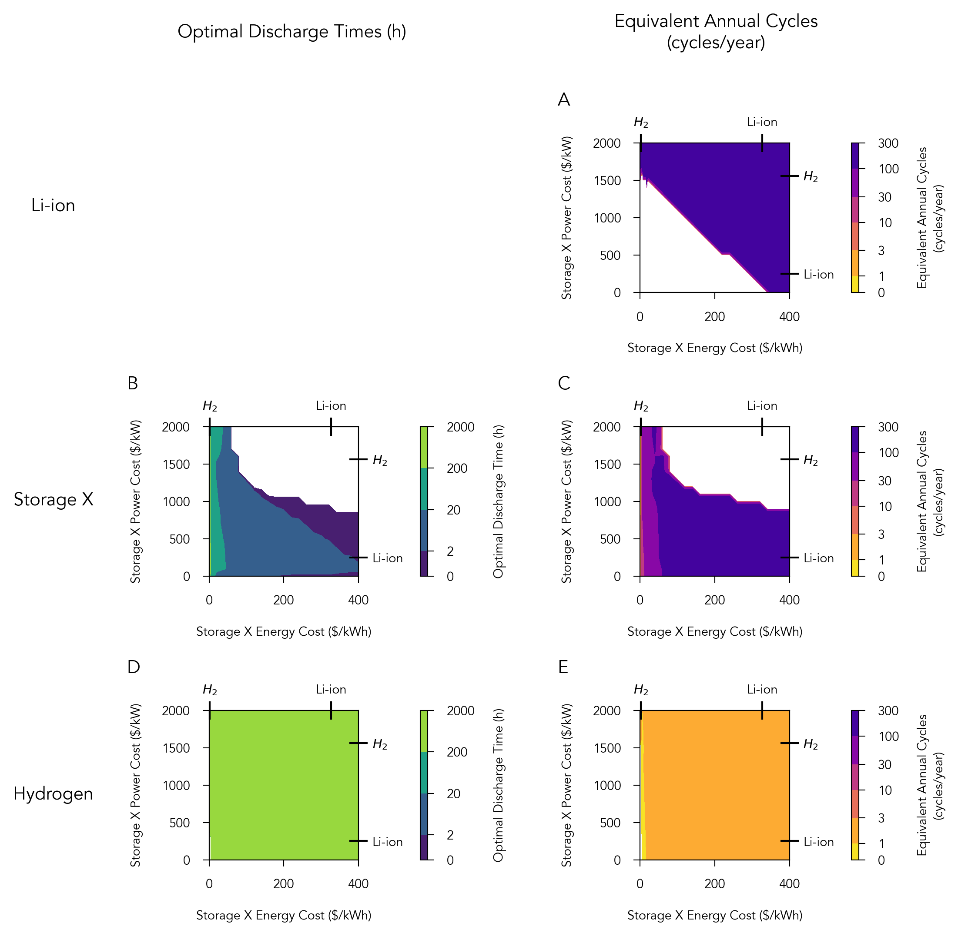

Slide 31
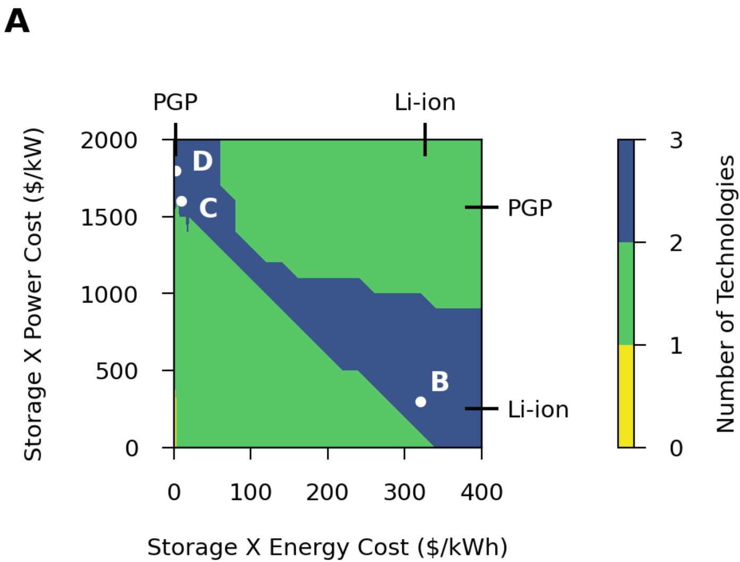
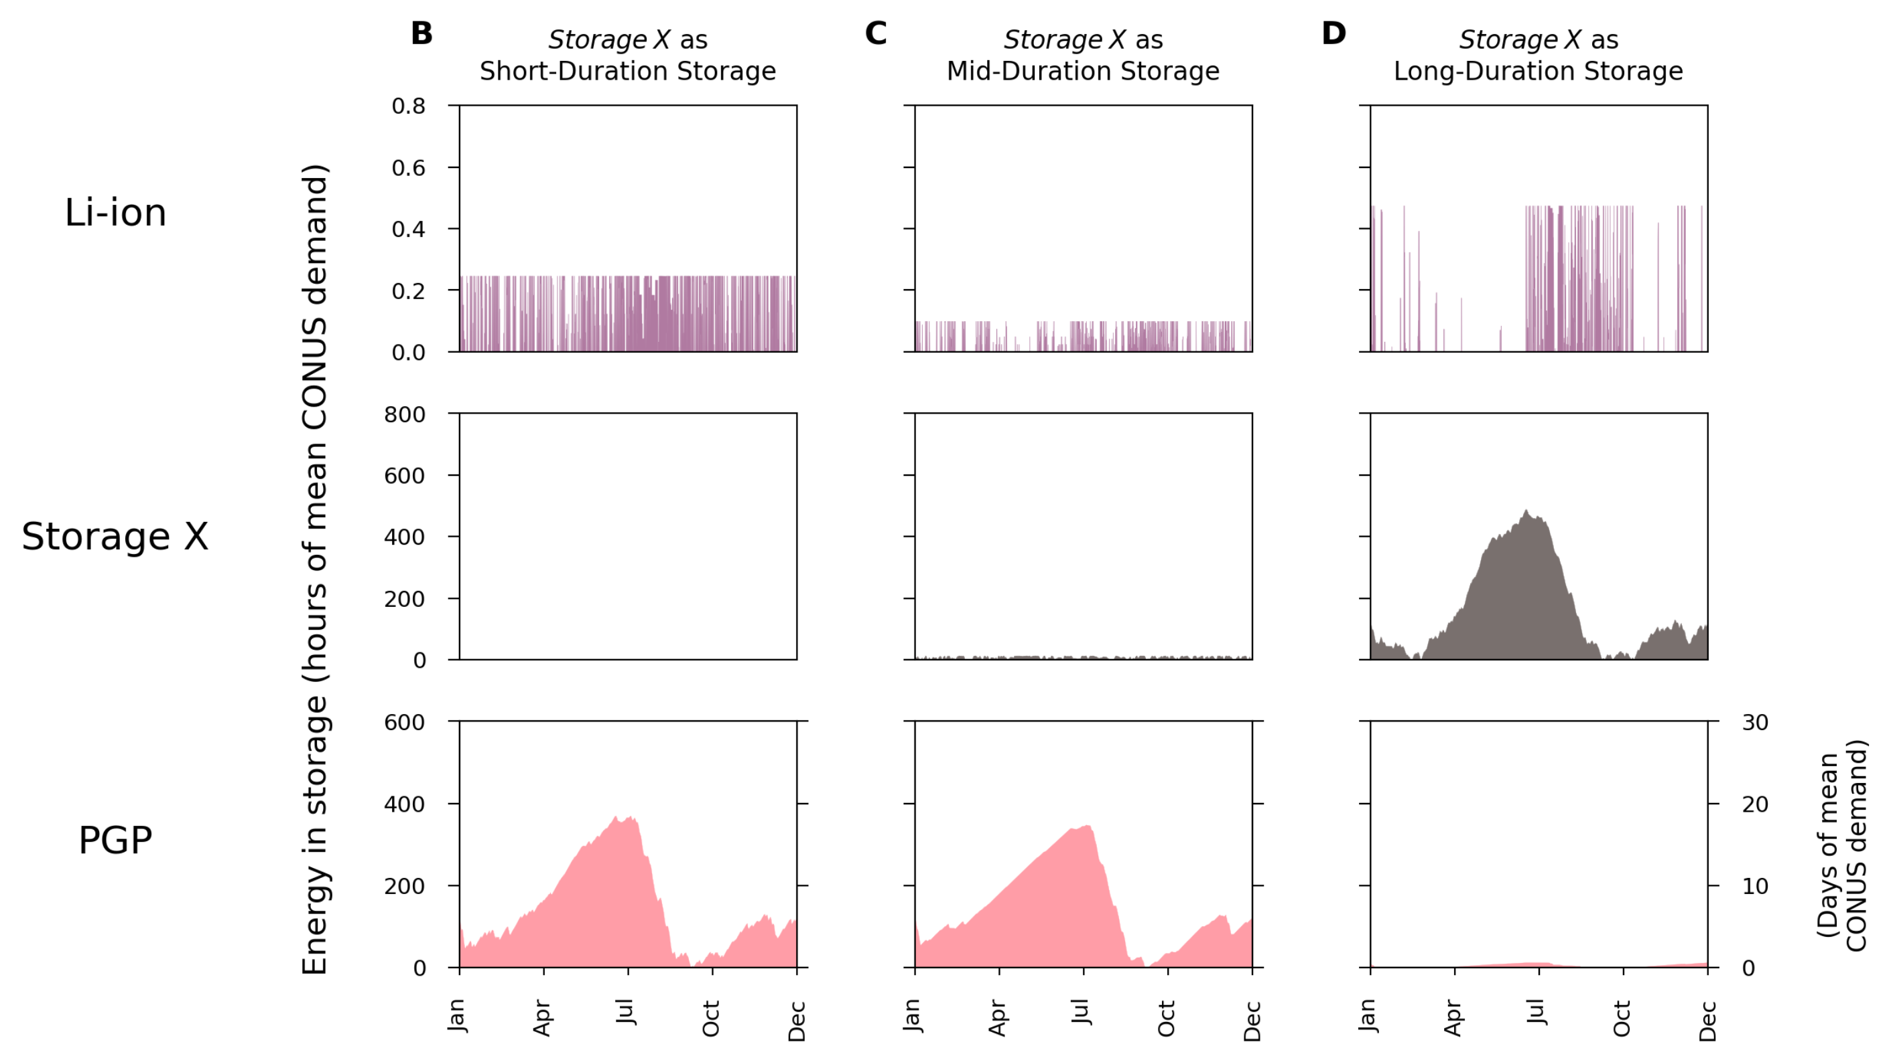
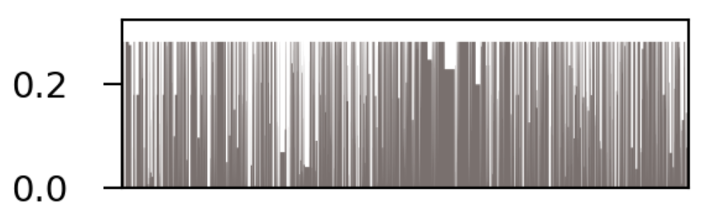
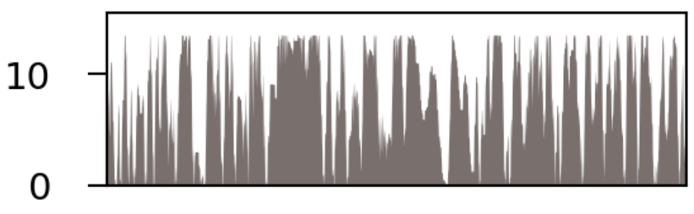
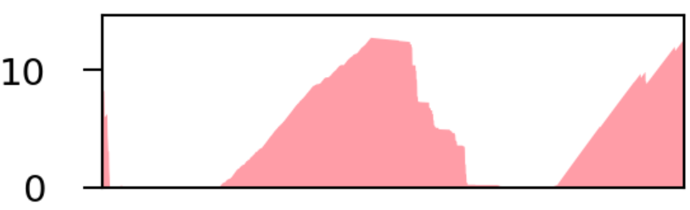
Li-ion + Hydrogen
Hydrogen
+ Storage X
Li-ion + Hydrogen + Storage X
Only Storage X
261 cycles/year
191 cycles/year
89 cycles/year
2.8 hour discharge
262 cycles/year
28 hour discharge
55 cycles/year
854 hour discharge
2.4 cycles/year
513 discharge
1.6 cycles/year
810 hour discharge
1.0 cycles/year
49 hour discharge
1.5 cycles/year

Slide 32
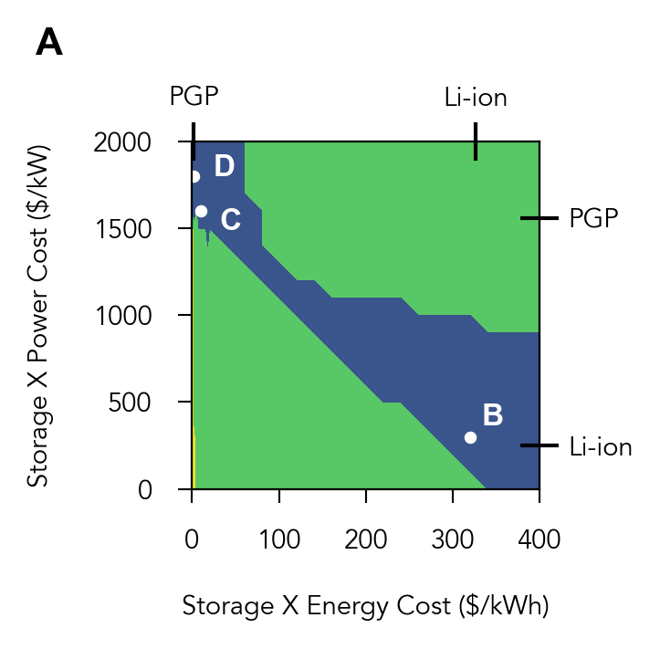

Li-ion + Hydrogen
Hydrogen
+ Storage X
Li-ion + Hydrogen + Storage X
Only Storage X
261 cycles/year
191 cycles/year
89 cycles/year
2.8 hour discharge
262 cycles/year
28 hour discharge
55 cycles/year
854 hour discharge
2.4 cycles/year
513 discharge
1.6 cycles/year
810 hour discharge
1.0 cycles/year
49 hour discharge
1.5 cycles/year

Slide 33
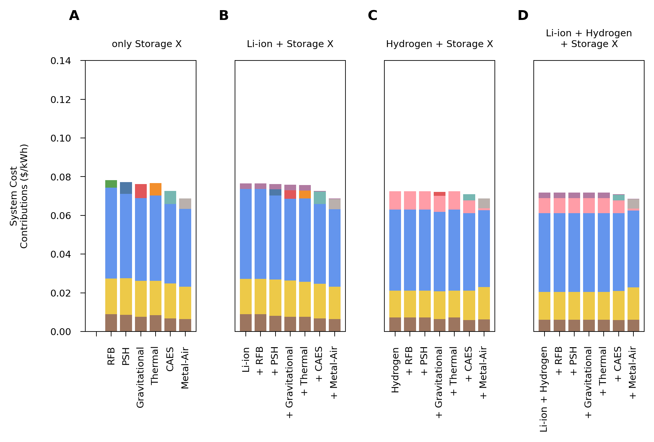
Thermal
Li-ion
Hydrogen
RFB
PSH
Gravity
CAES
M-Air
Wind
Wind
Wind
Wind
Solar
Solar
Solar
Solar
Natural Gas
Natural Gas
Natural Gas
Natural Gas

Slide 34
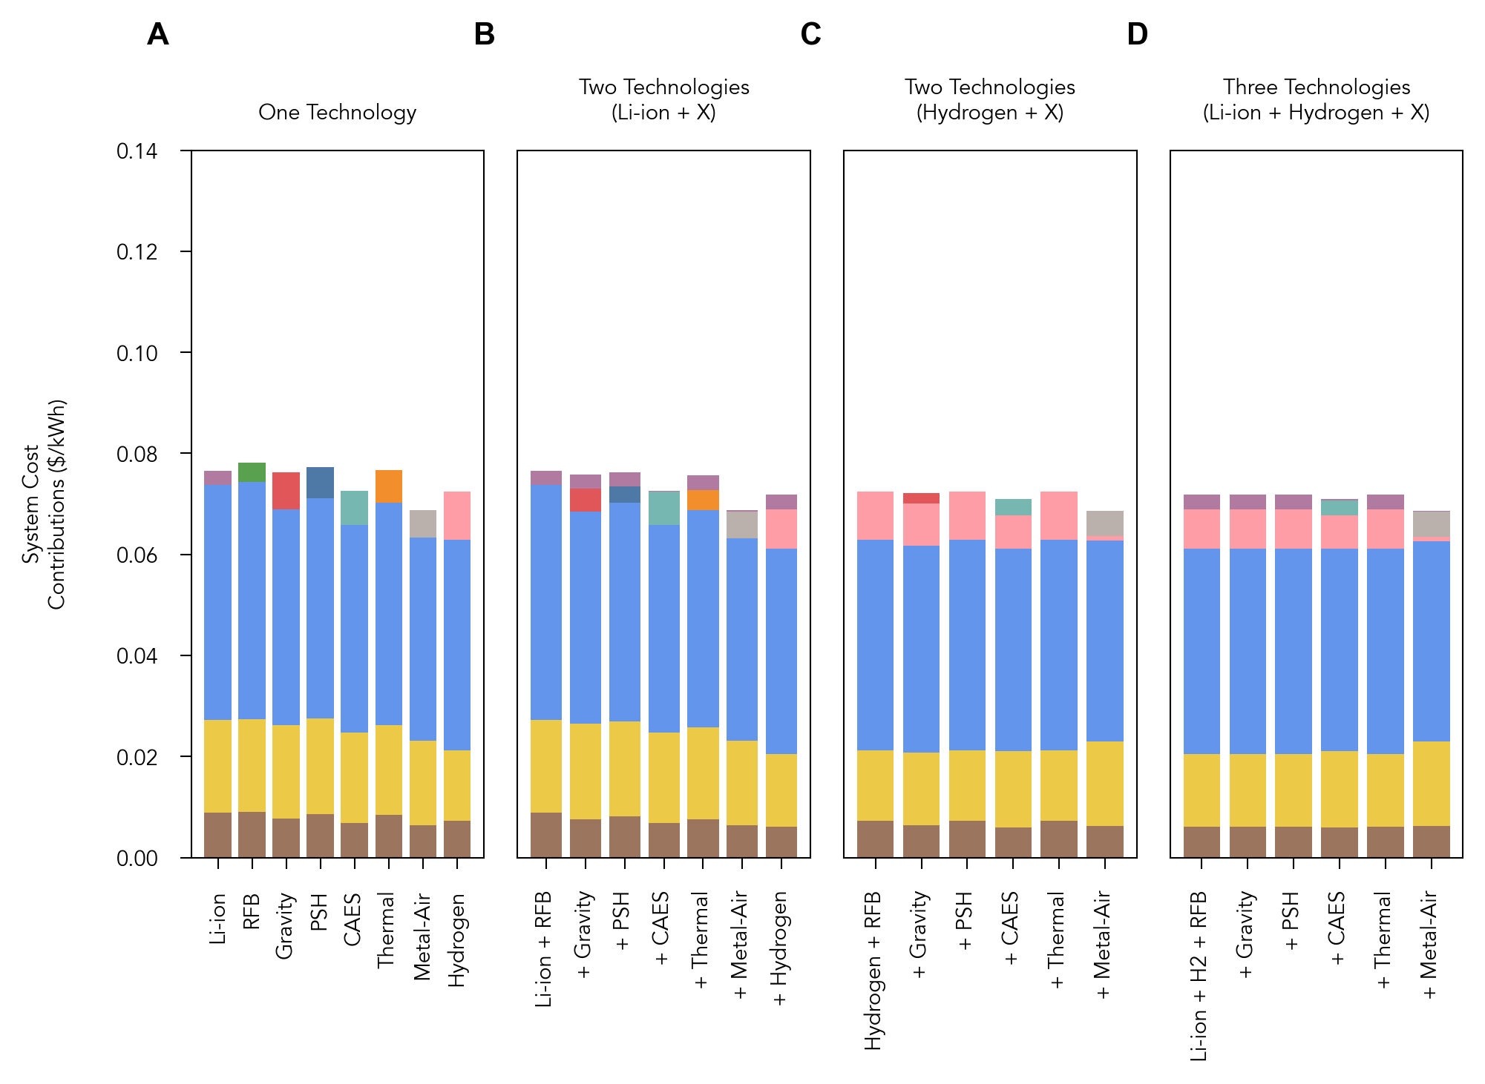
Li-ion
Hydrogen
Li-ion
RFB
Gravity
PSH
Thermal
Hydrogen
CAES
Metal-Air
Wind
Wind
Wind
Wind
Solar
Solar
Solar
Solar
Natural Gas
Natural Gas
Natural Gas
Natural Gas

Slide 35
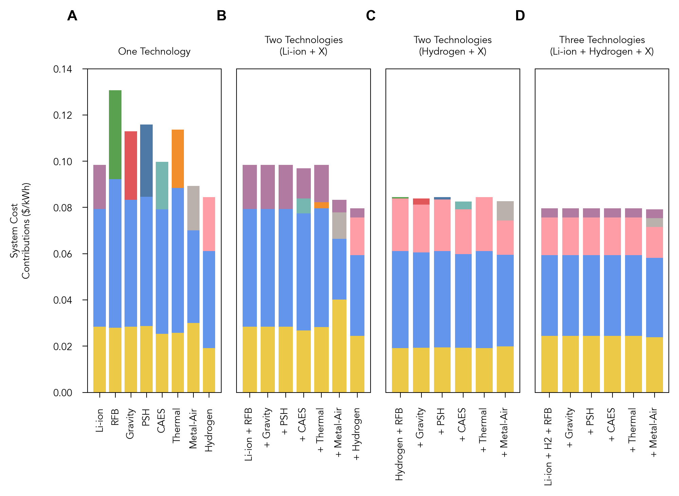
RFB
Li-ion
Gravity
PSH
Thermal
Li-ion
Li-ion
CAES
Metal-Air
Hydrogen
Hydrogen
Hydrogen
Wind
Wind
Wind
Wind
Solar
Solar
Solar
Solar

Slide 36
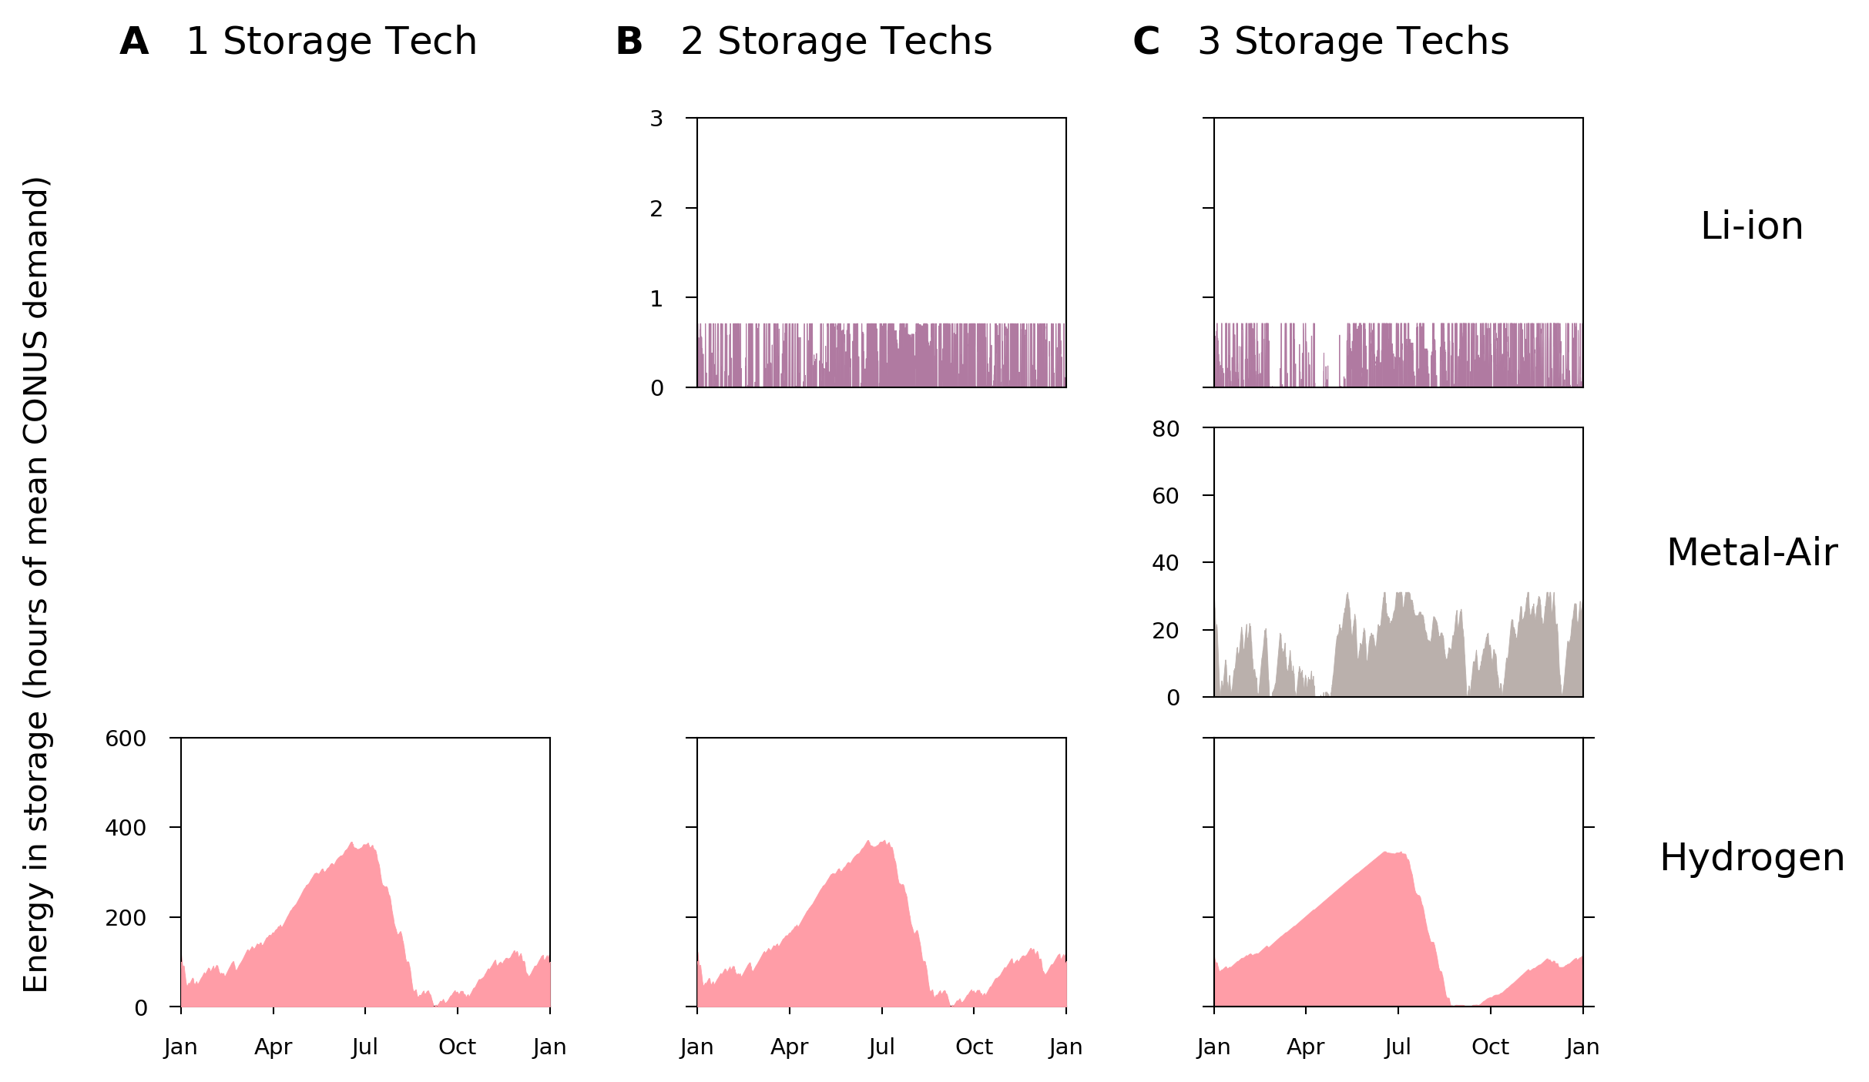
232 cycles/year
209 cycles/year
(fixed 4-hour discharge)
15 cycles/year
(fixed 100-hour discharge)
419-hour discharge
1.7 cycles/year
522-hour discharge
1.5 cycles/year
823-hour discharge
0.87 cycles/year

Slide 37
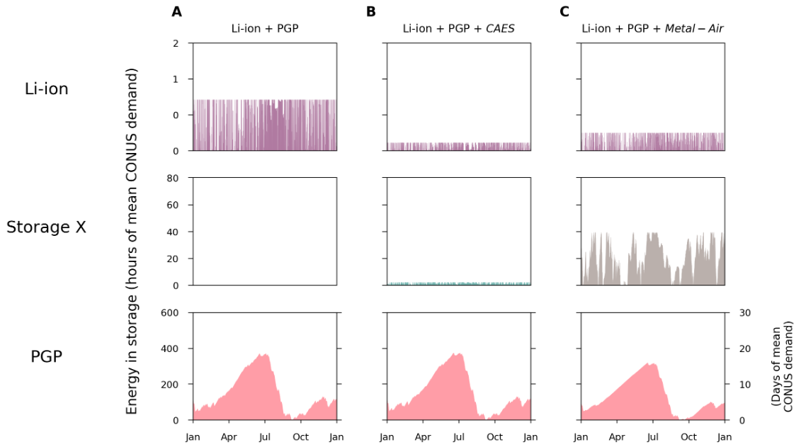
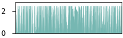
* Figure 6
The role of technologies (timescale at which they store energy) is dependent on how their characteristics compare to other technologies competing in the system.
232 cycles/year
294 cycles/year
295 cycles/year
11 hour discharge
84 cycles/year
87 hour discharge
20 cycles/year
Not modeled
522 hour discharge
1.5 cycles/year
583 hour discharge
1.4 cycles/year
833 hour discharge
1.1 cycles/year

Slide 38
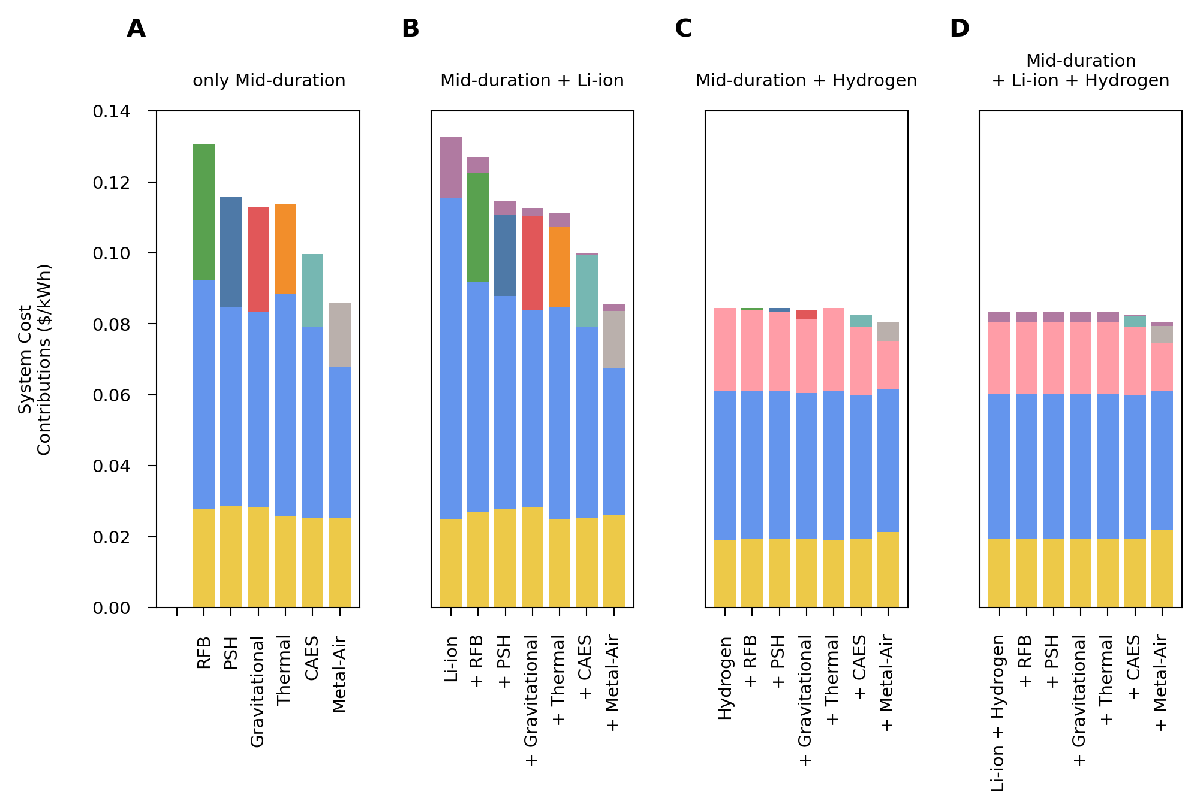
Metal-Air with Independent Energy and Power Capacities (MIT Costs)

Slide 39
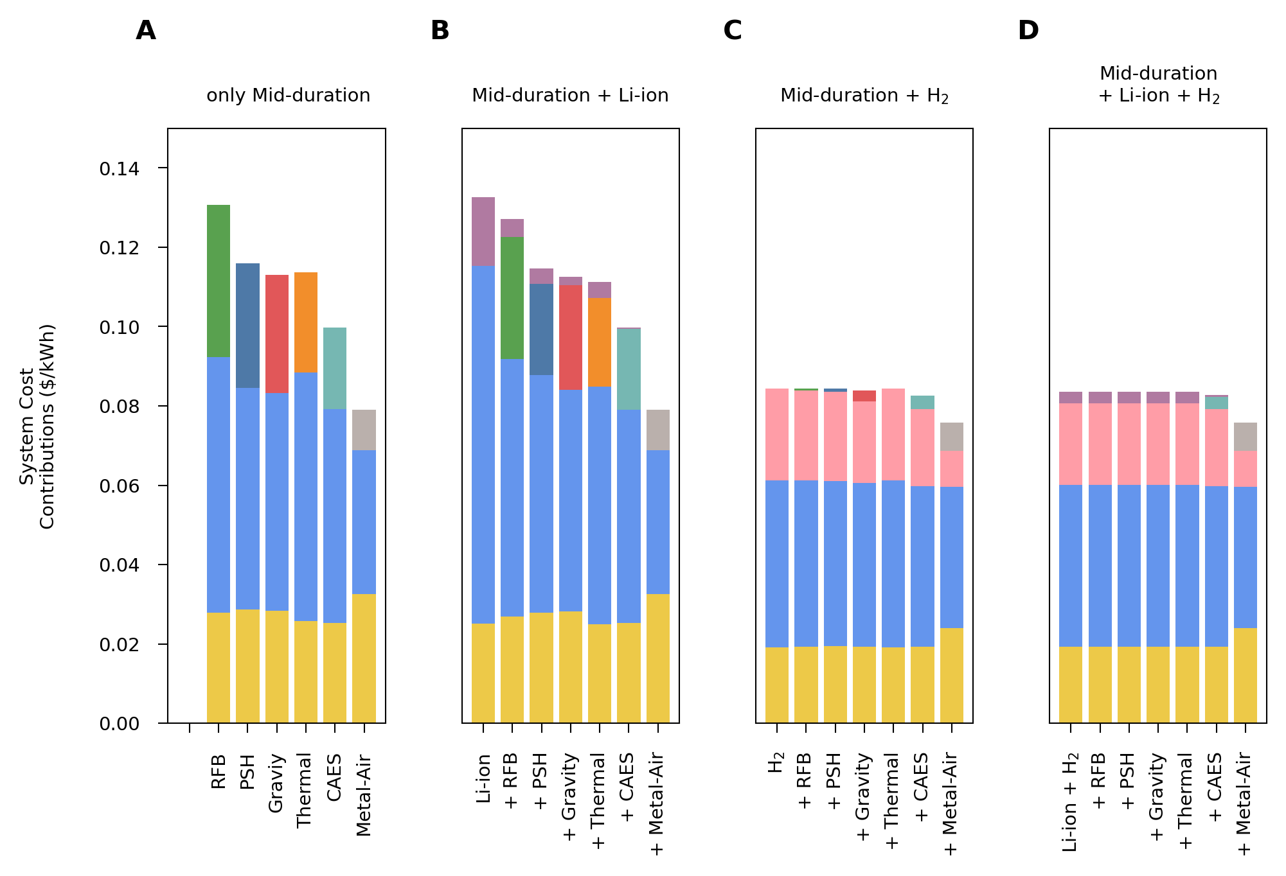

Metal-air with 100h duration (MIT Costs)
† Li-ion is not cost competitive
* Mid-duration storage is not cost competitive
* Mid-duration storage is not cost competitive
Li-ion
† Li-ion is not cost competitive
System Cost Reduction
RFB
RFB
†
PSH
Thermal
PSH
Li-ion
Gravity
Gravity
M-Air
Thermal
M-Air
*
*
*
*
*
CAES
CAES
†
Hydrogen
Hydrogen
Wind
Wind
Wind
Wind
Solar
Solar
Solar
Solar

Slide 40
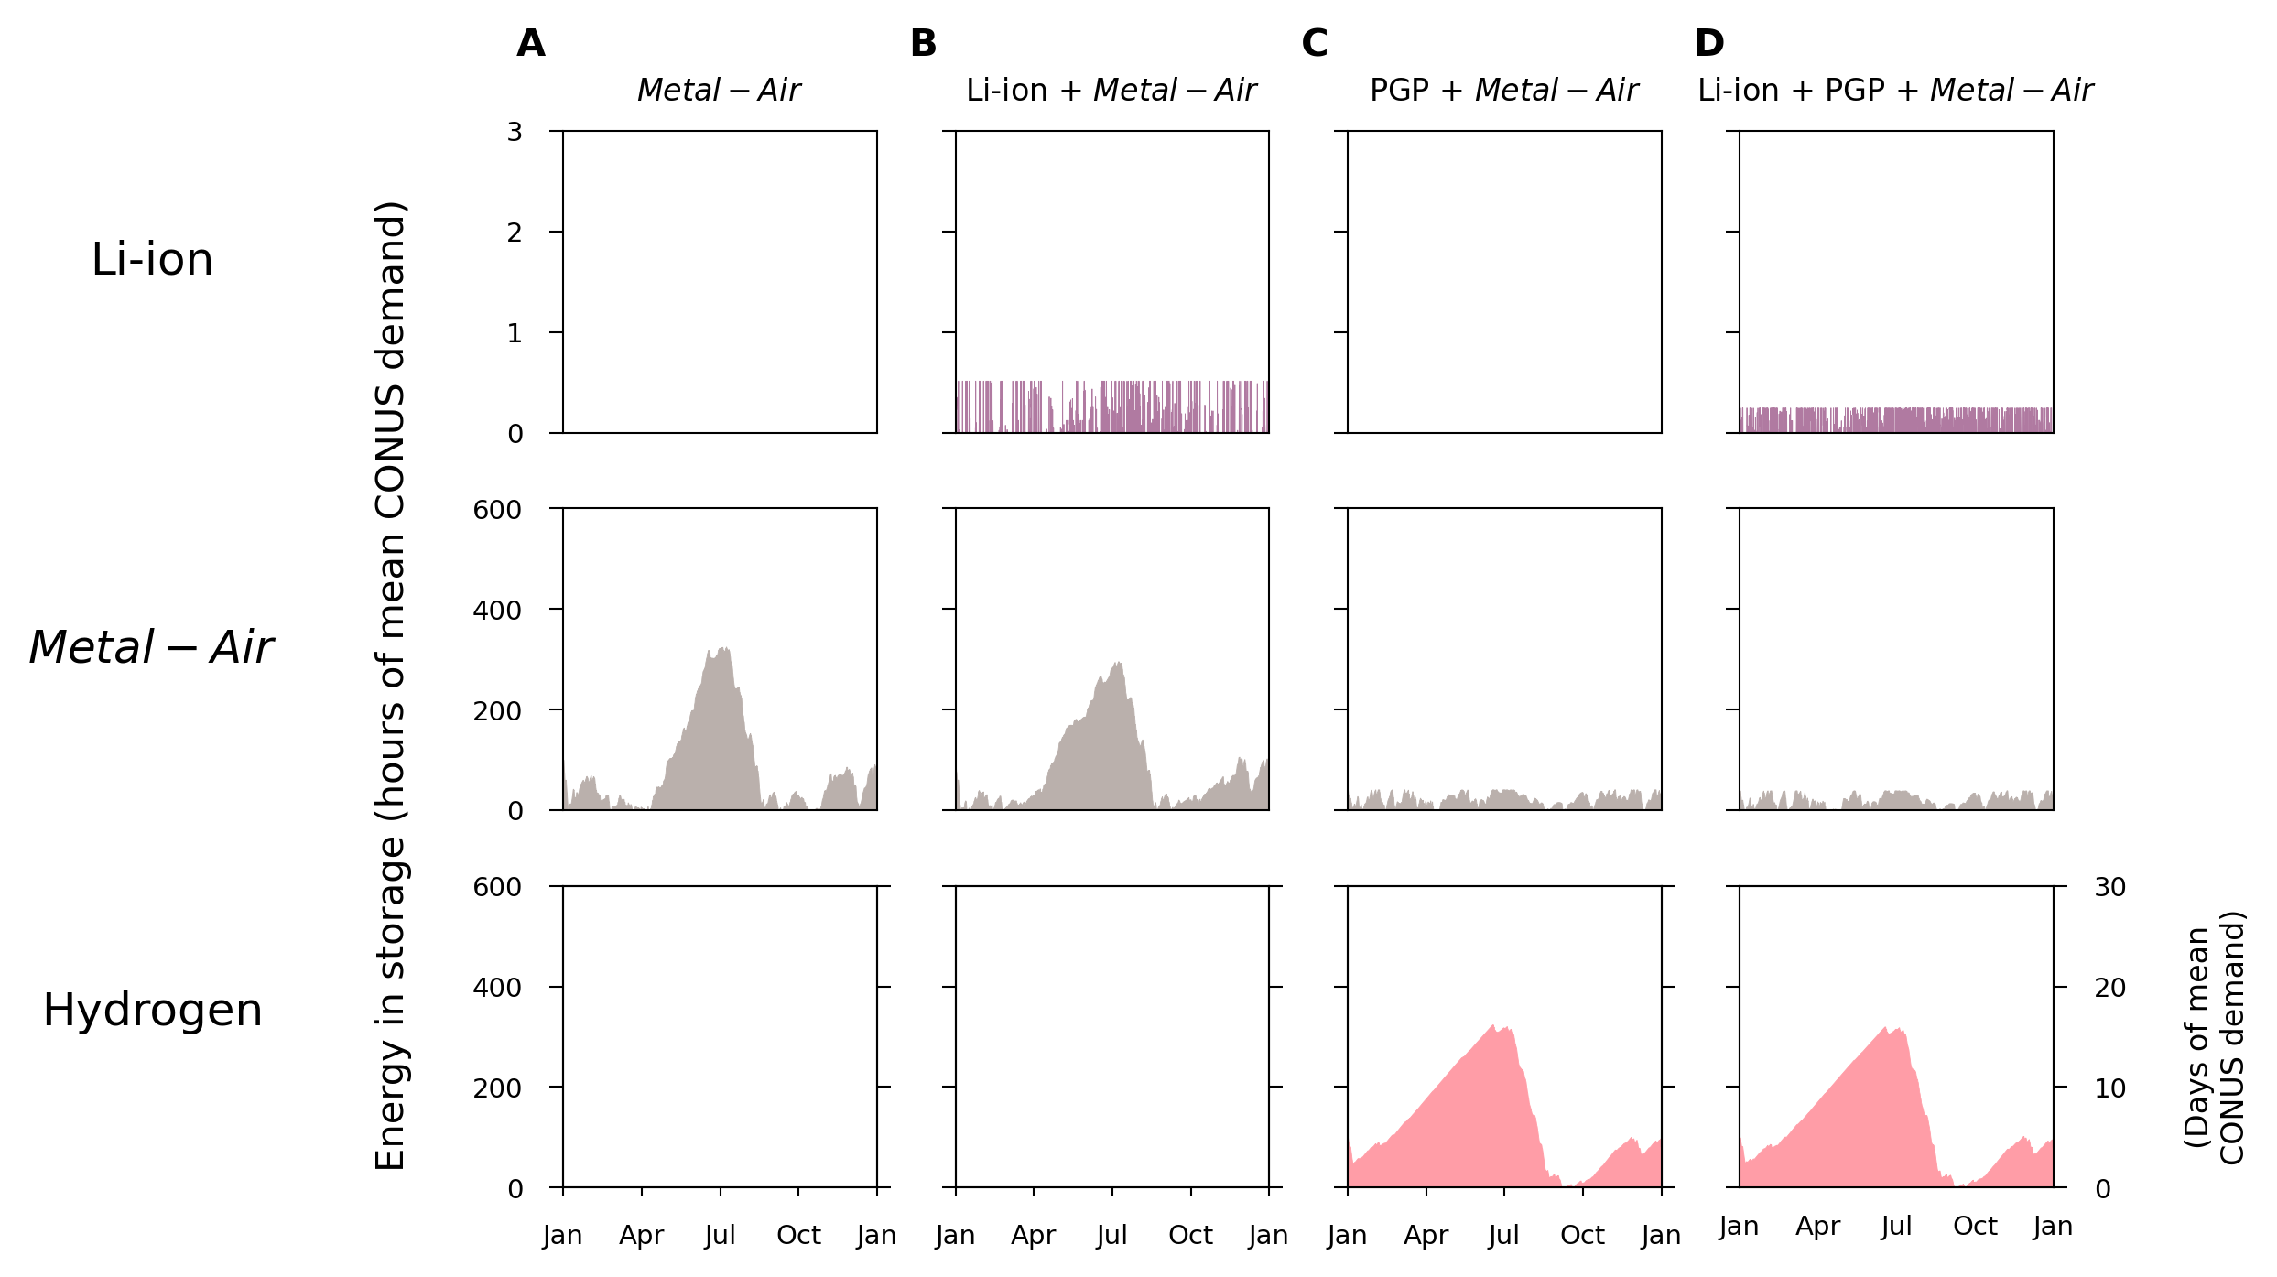
Metal-air with independent energy- and power-capacity (MIT Costs)
295 cycles/year
295 cycles/year
87 hour discharge
3.3 cycles/year
87 hour discharge
20 cycles/year
87 hour discharge
20 cycles/year
87 hour discharge
20 cycles/year
833 hour discharge
1.1 cycles/year
833 hour discharge
1.1 cycles/year

Slide 41

Metal-air with fixed energy- and power-capacity ratio of 100 hours (MIT costs)
Not Competitive
Not Competitive
6.6 cycles/year
6.6 cycles/year
10.1 cycles/year
10.1 cycles/year
1007 hour discharge
0.71 cycles/year
1007 hour discharge
0.71 cycles/year

Slide 42


